Slide 1

Advocacy Training 101
How to influence decisions and support healthy change for our kids & community

Slide 2
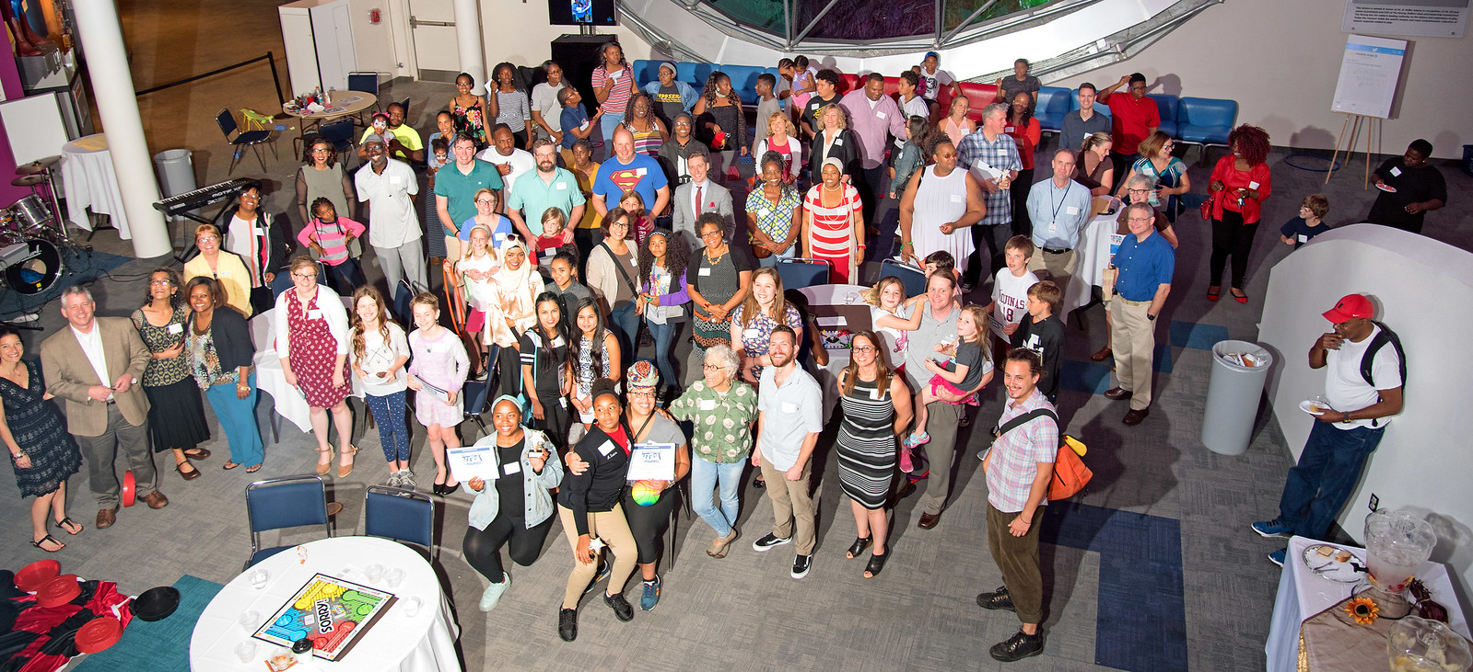
About Healthi Kids

Slide 3
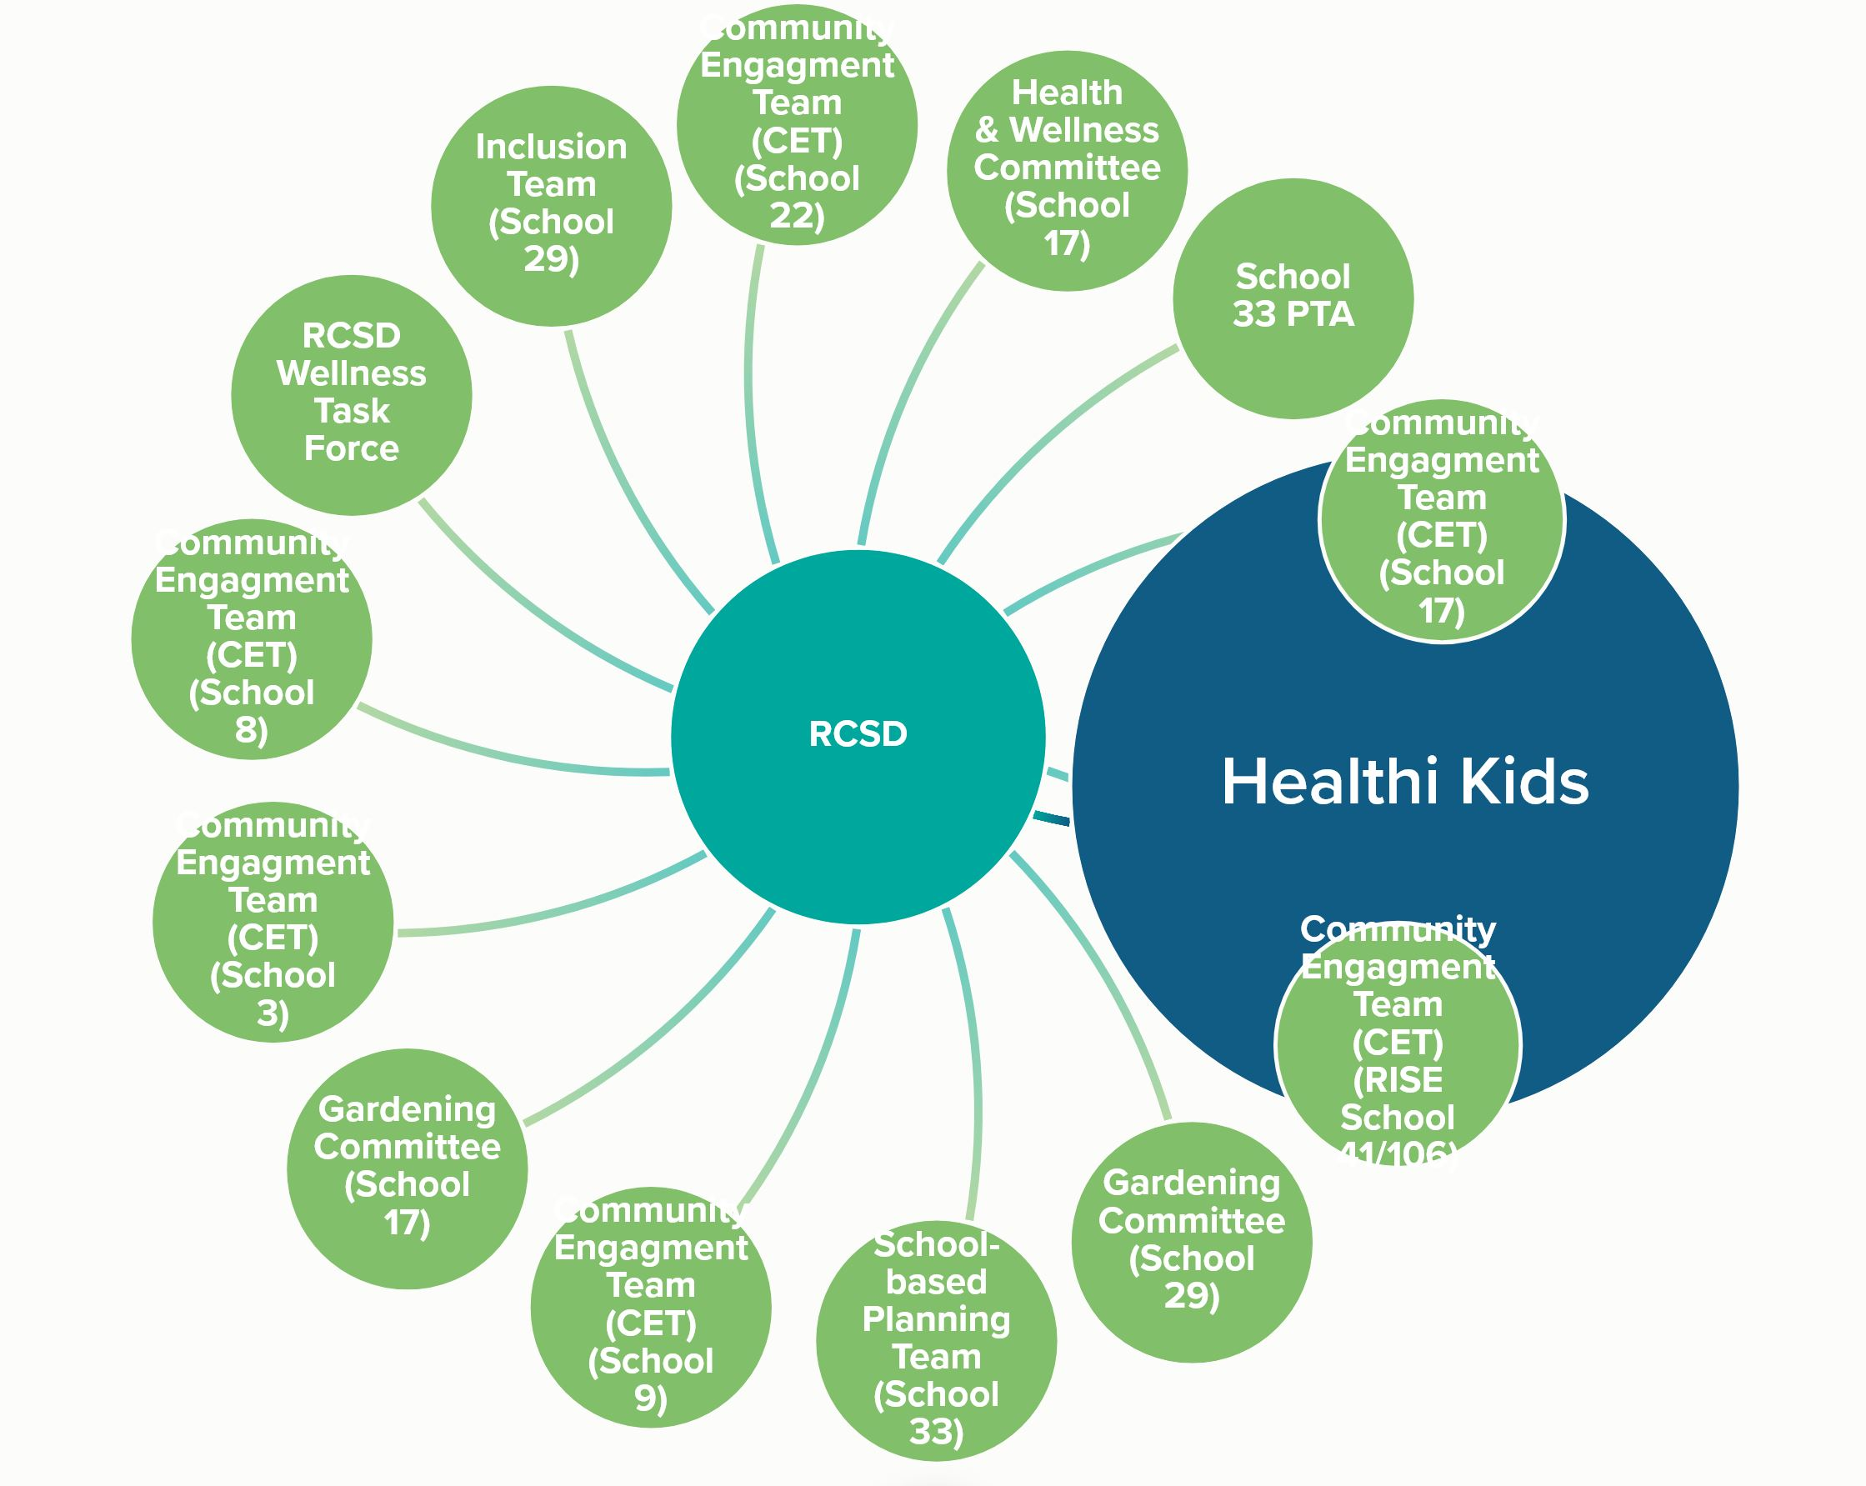
About Us
Our Coalition. Our Process. Our Impact.
Established in 2008
Serving the Finger Lakes region
More than 45+ community advocates
Team sits at 70+ tables across the community

Slide 4
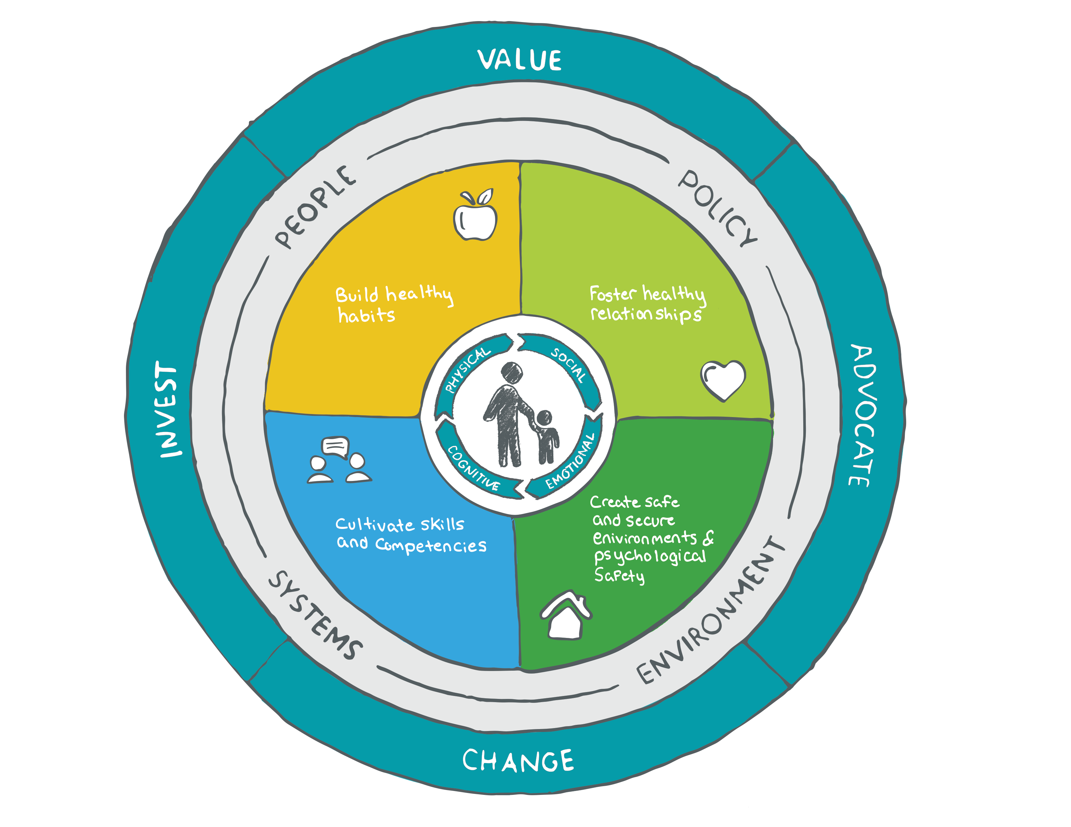
Healthi Kids Change Agenda

Slide 5
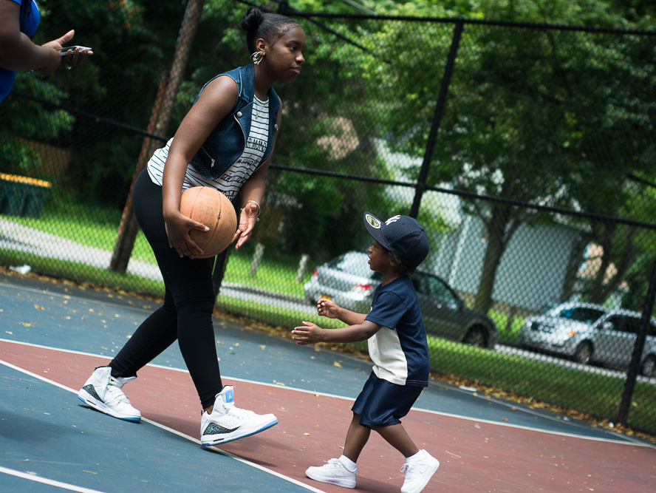
Why Whole Child Health?

Slide 6

Brain Architecture and Early Development
Critical
& sensitive developmental periods
Chronic Disease
Psychiatric Disorders
Impaired Cognition
Work/School (Attendance, behavior, performance)
Obesity
Alcohol, Tobacco, Drugs
Risky Sex
Crime
Poverty
Intergenerational Transmission, Disparity
Adverse Childhood Experiences
Genetics
Notes:
Why we are in this space of whole child health
Brain Architecture
Genetics: Genes and experiences work together to develop the brain in an ongoing process from before birth into adulthood.
Adverse Childhood Experiences can activate the stress response and prolonged activation can lead to toxic stress.
Transition to brain development / middle of slide:
Toxic stress impairs the development of neural connections and brain architecture, especially in the frontal cortex, and organ systems.
Essentially, the areas of the brain dedicated to higher-order skills, such as Executive Function and Self-regulation skills - the mental processes that enable us to plan, focus attention, remember instructions and juggle multiple tasks successfully.
Transition to list / right side of slide:
The impact of ACEs across a lifespan can be individual and/or community wide, and can include (list on slide):

Slide 7
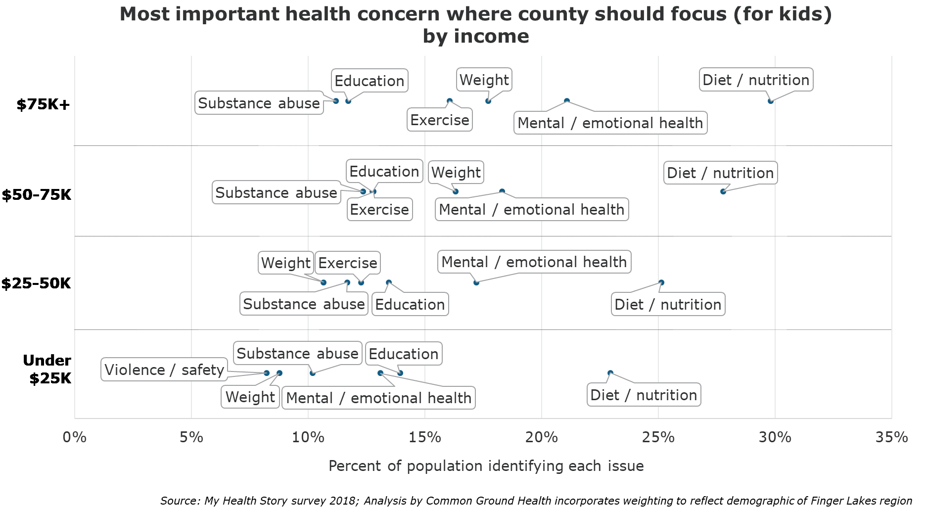
My Health Story

Slide 8
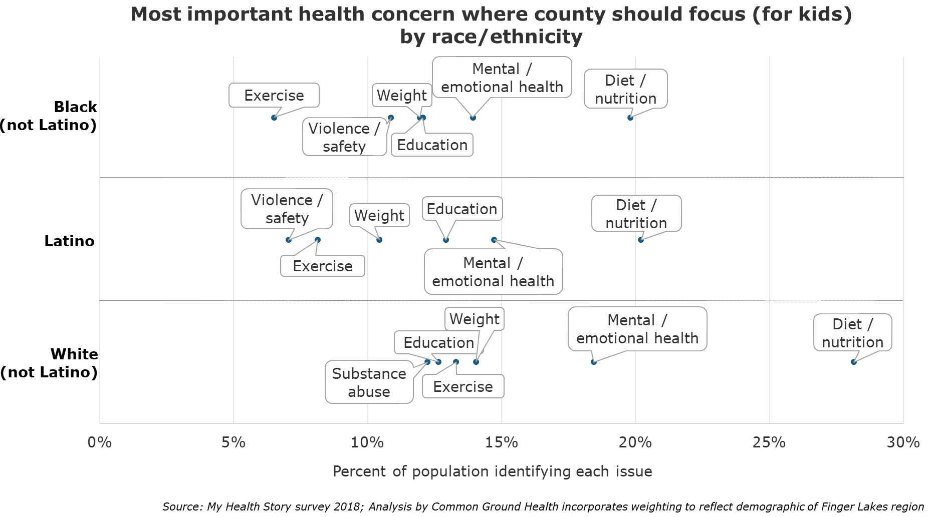
My Health Story

Slide 9
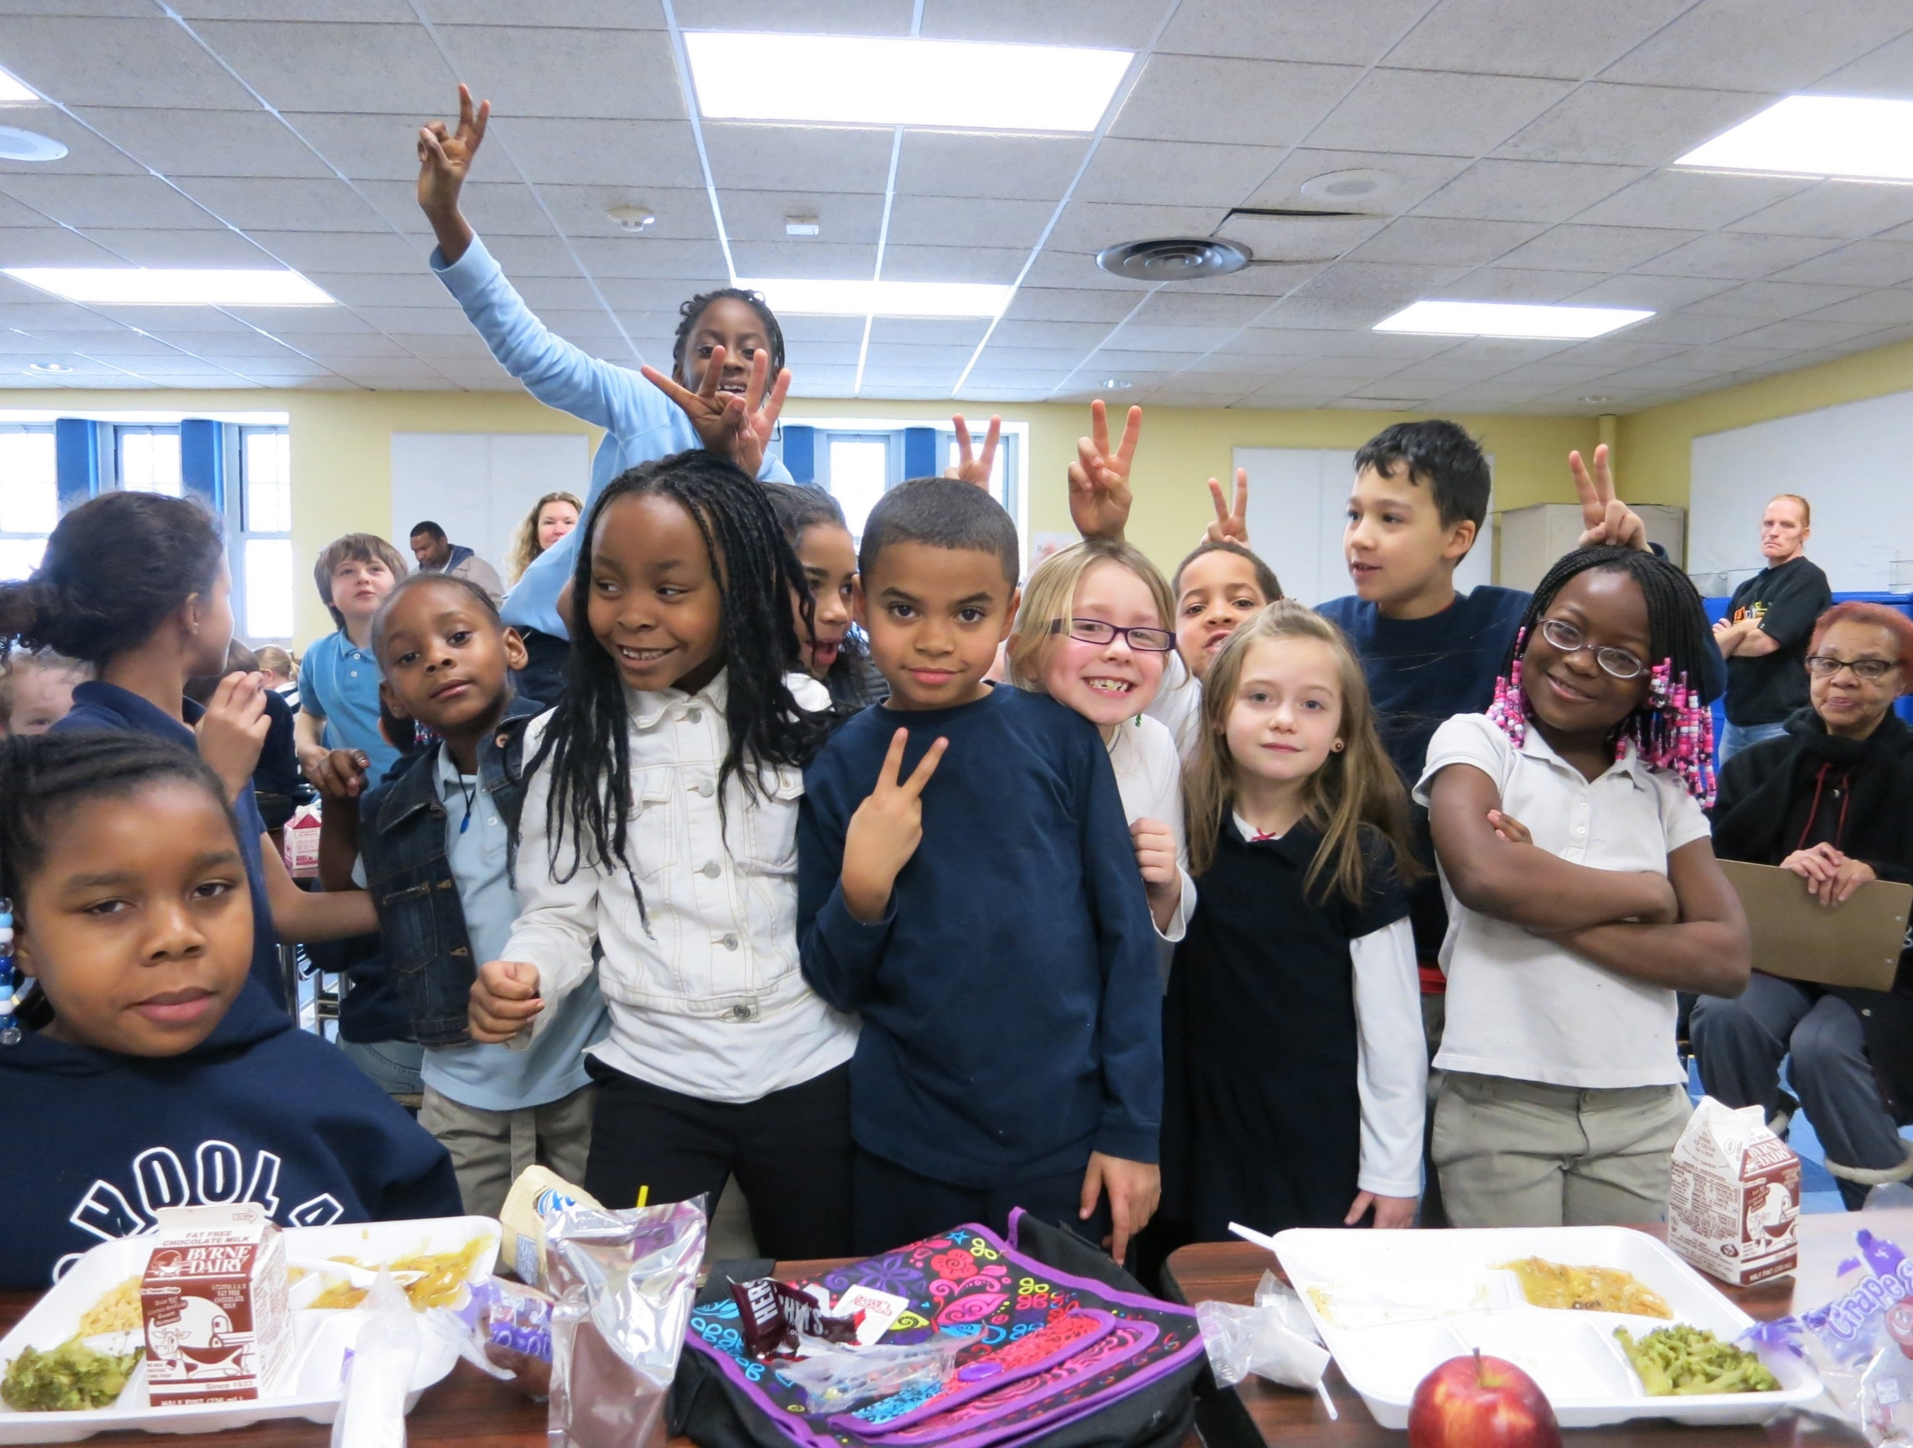
Our Advocacy Agenda

Slide 10
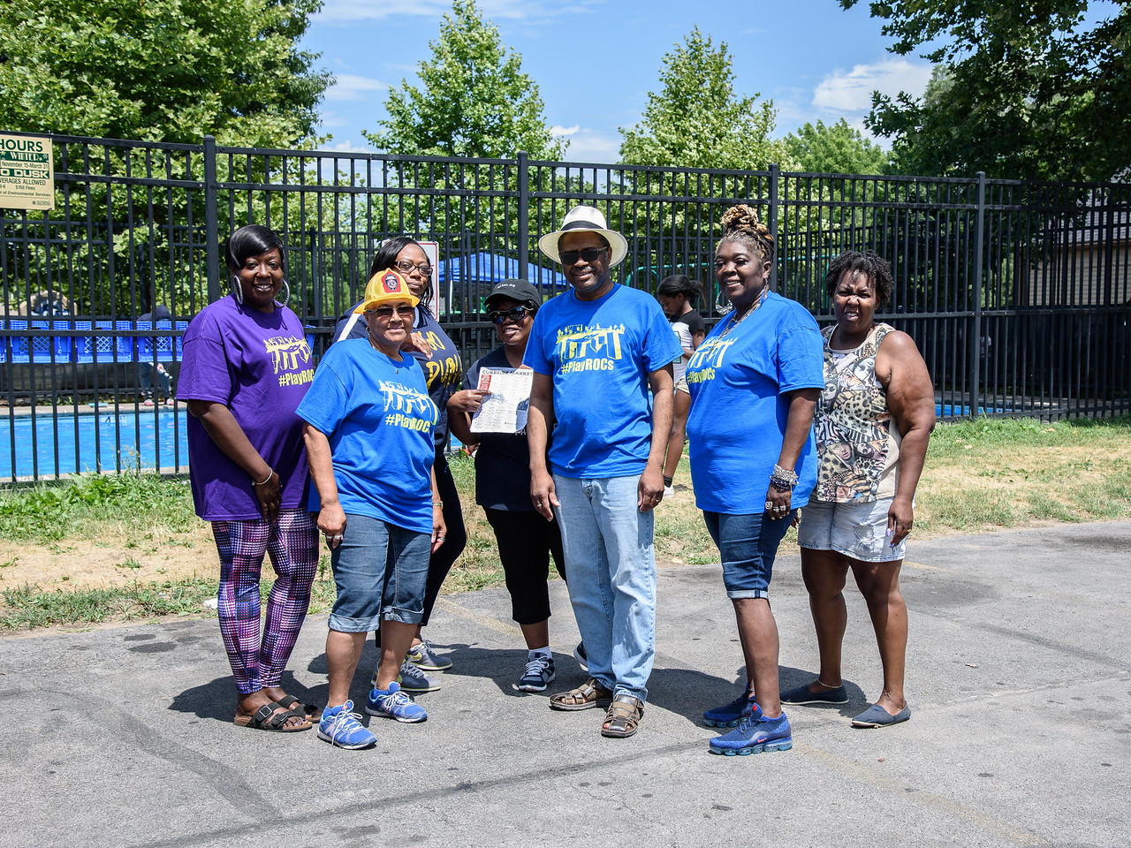
It takes a village to put kids first – a connected community of caring adults to support them, and safe and supportive environments that will allow them to thrive.
Notes:
Always with the lens that we are promoting trauma-informed, culturally responsive and health equity
All potential policy solutions recognize the impact Adverse Childhood Experiences (ACES), community violence, implicit bias, structural racism and health inequities have on children and families across the region.

Slide 11
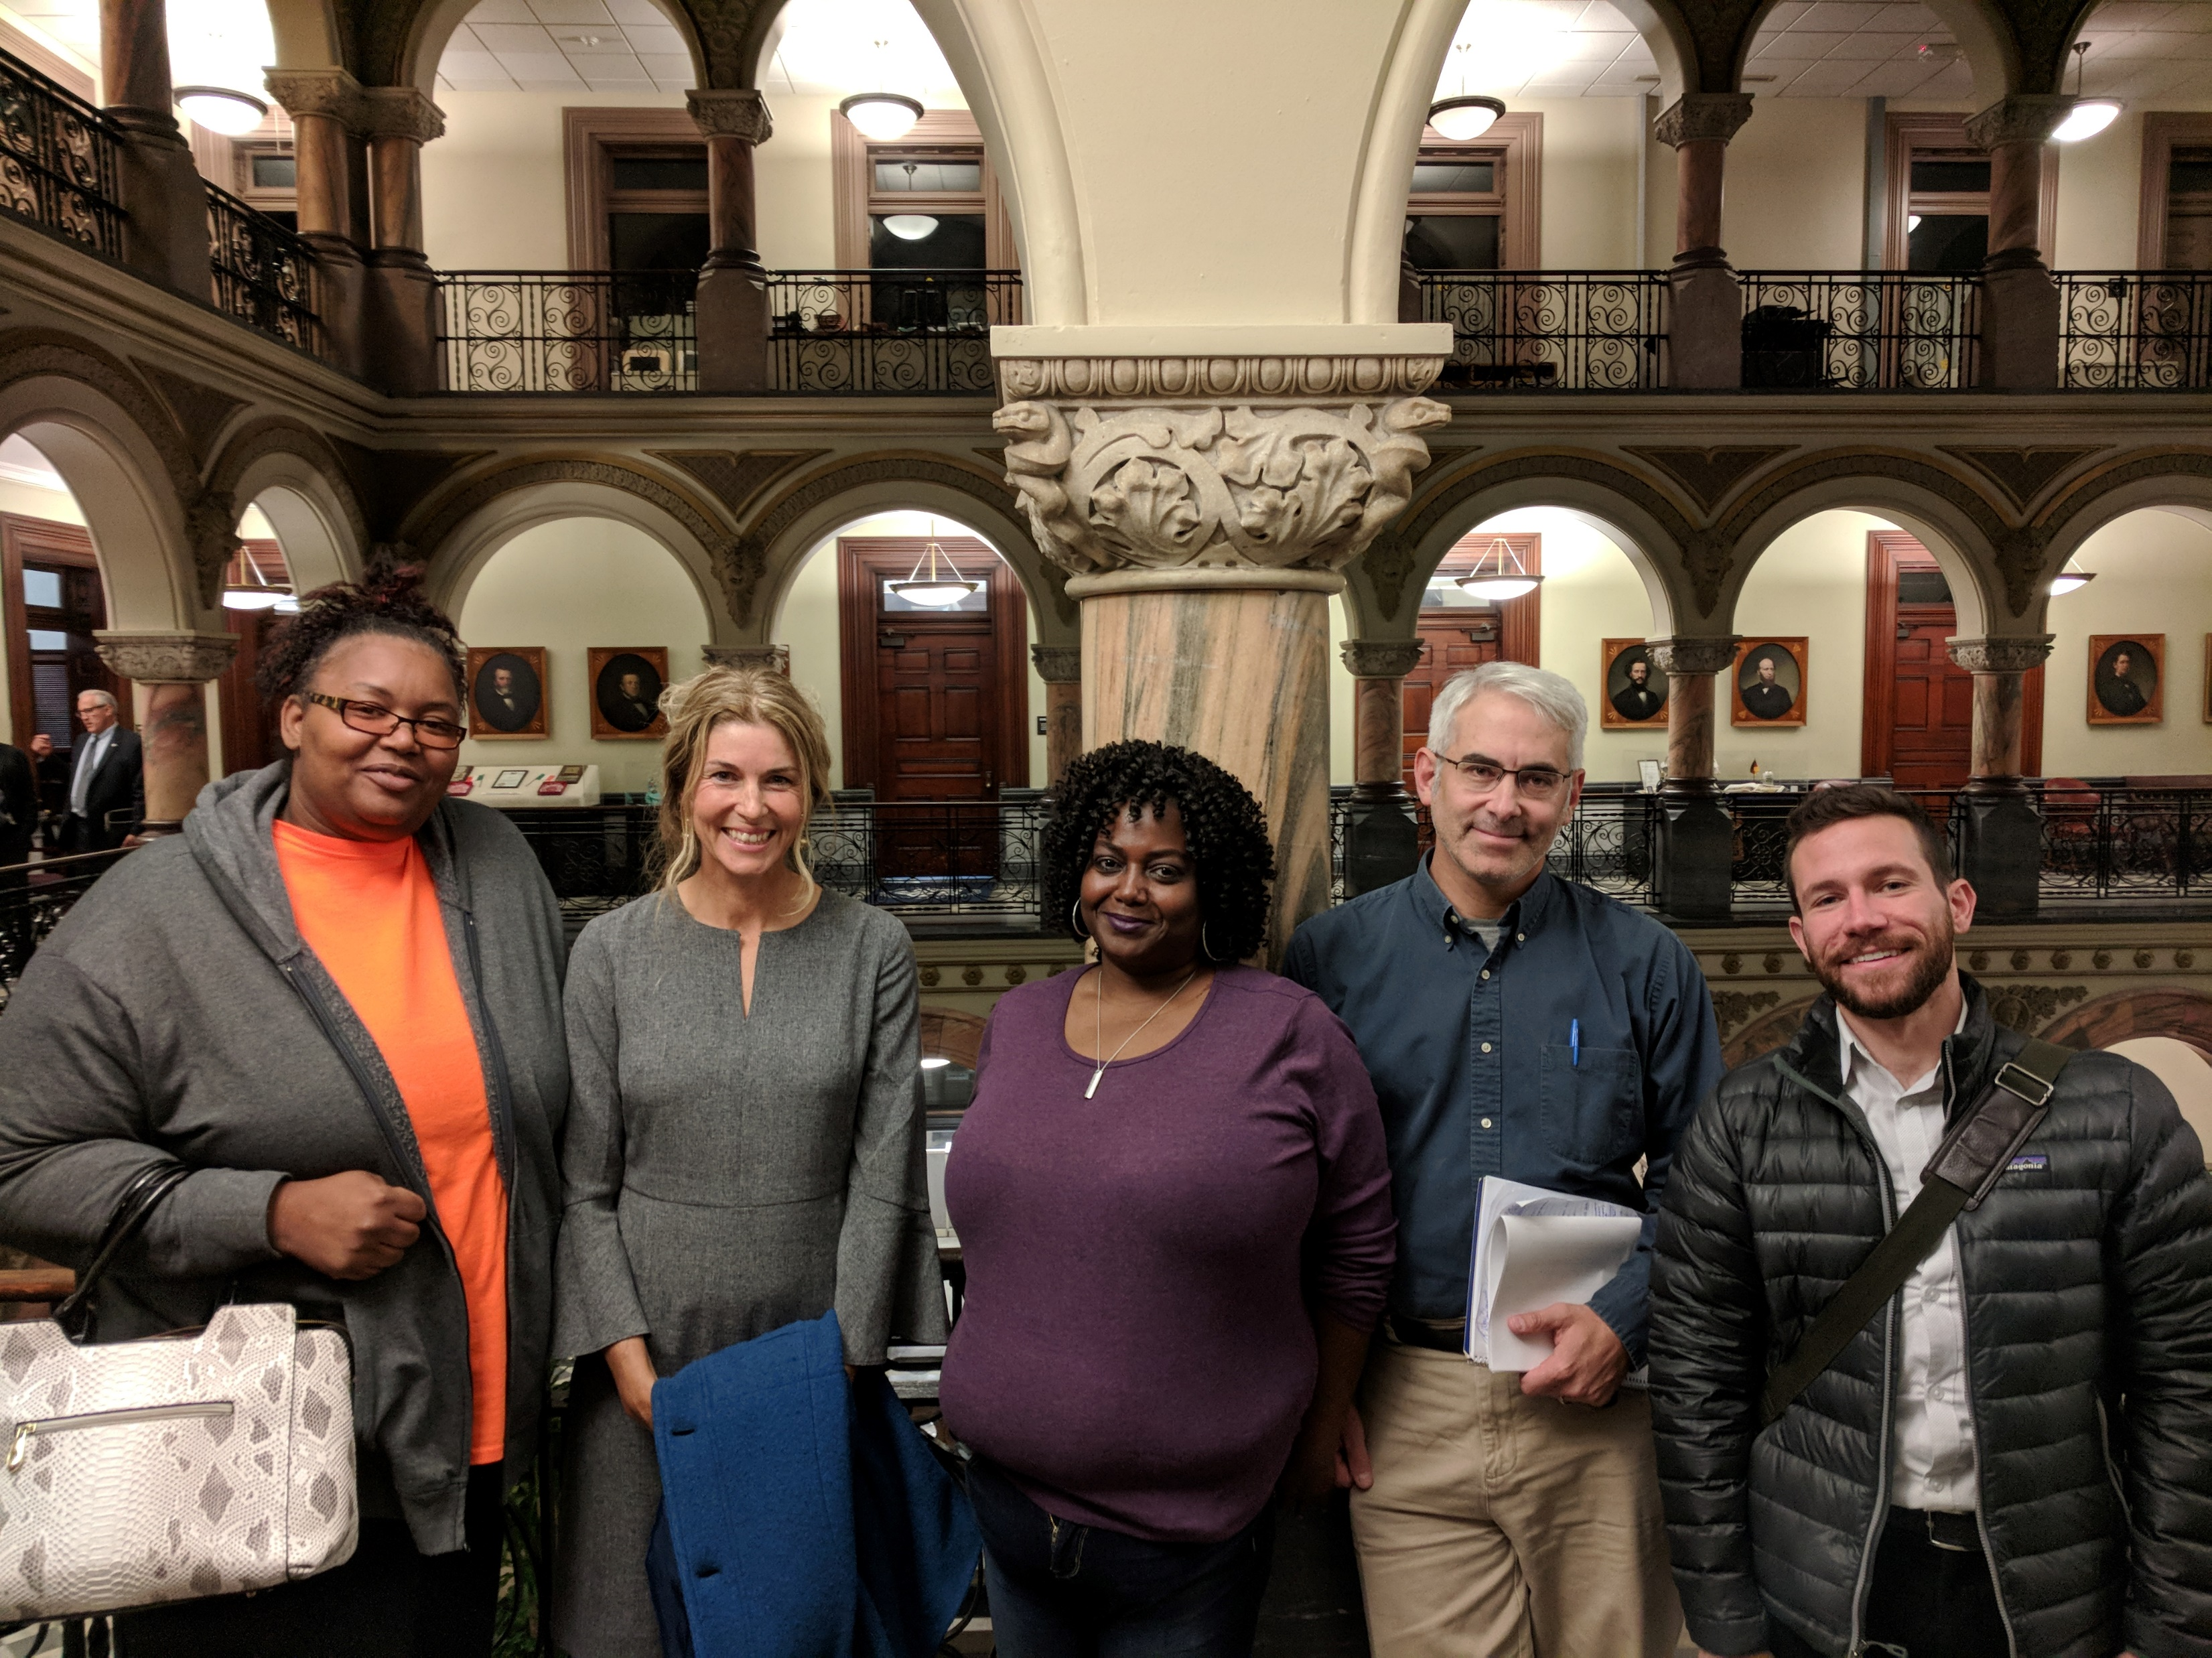
Together we must abolish inequities caused by adverse childhood experiences, structural racism, poverty and community violence to support our youngest children.
Notes:
Always with the lens that we are promoting trauma-informed, culturally responsive and health equity
All potential policy solutions recognize the impact Adverse Childhood Experiences (ACES), community violence, implicit bias, structural racism and health inequities have on children and families across the region.

Slide 12
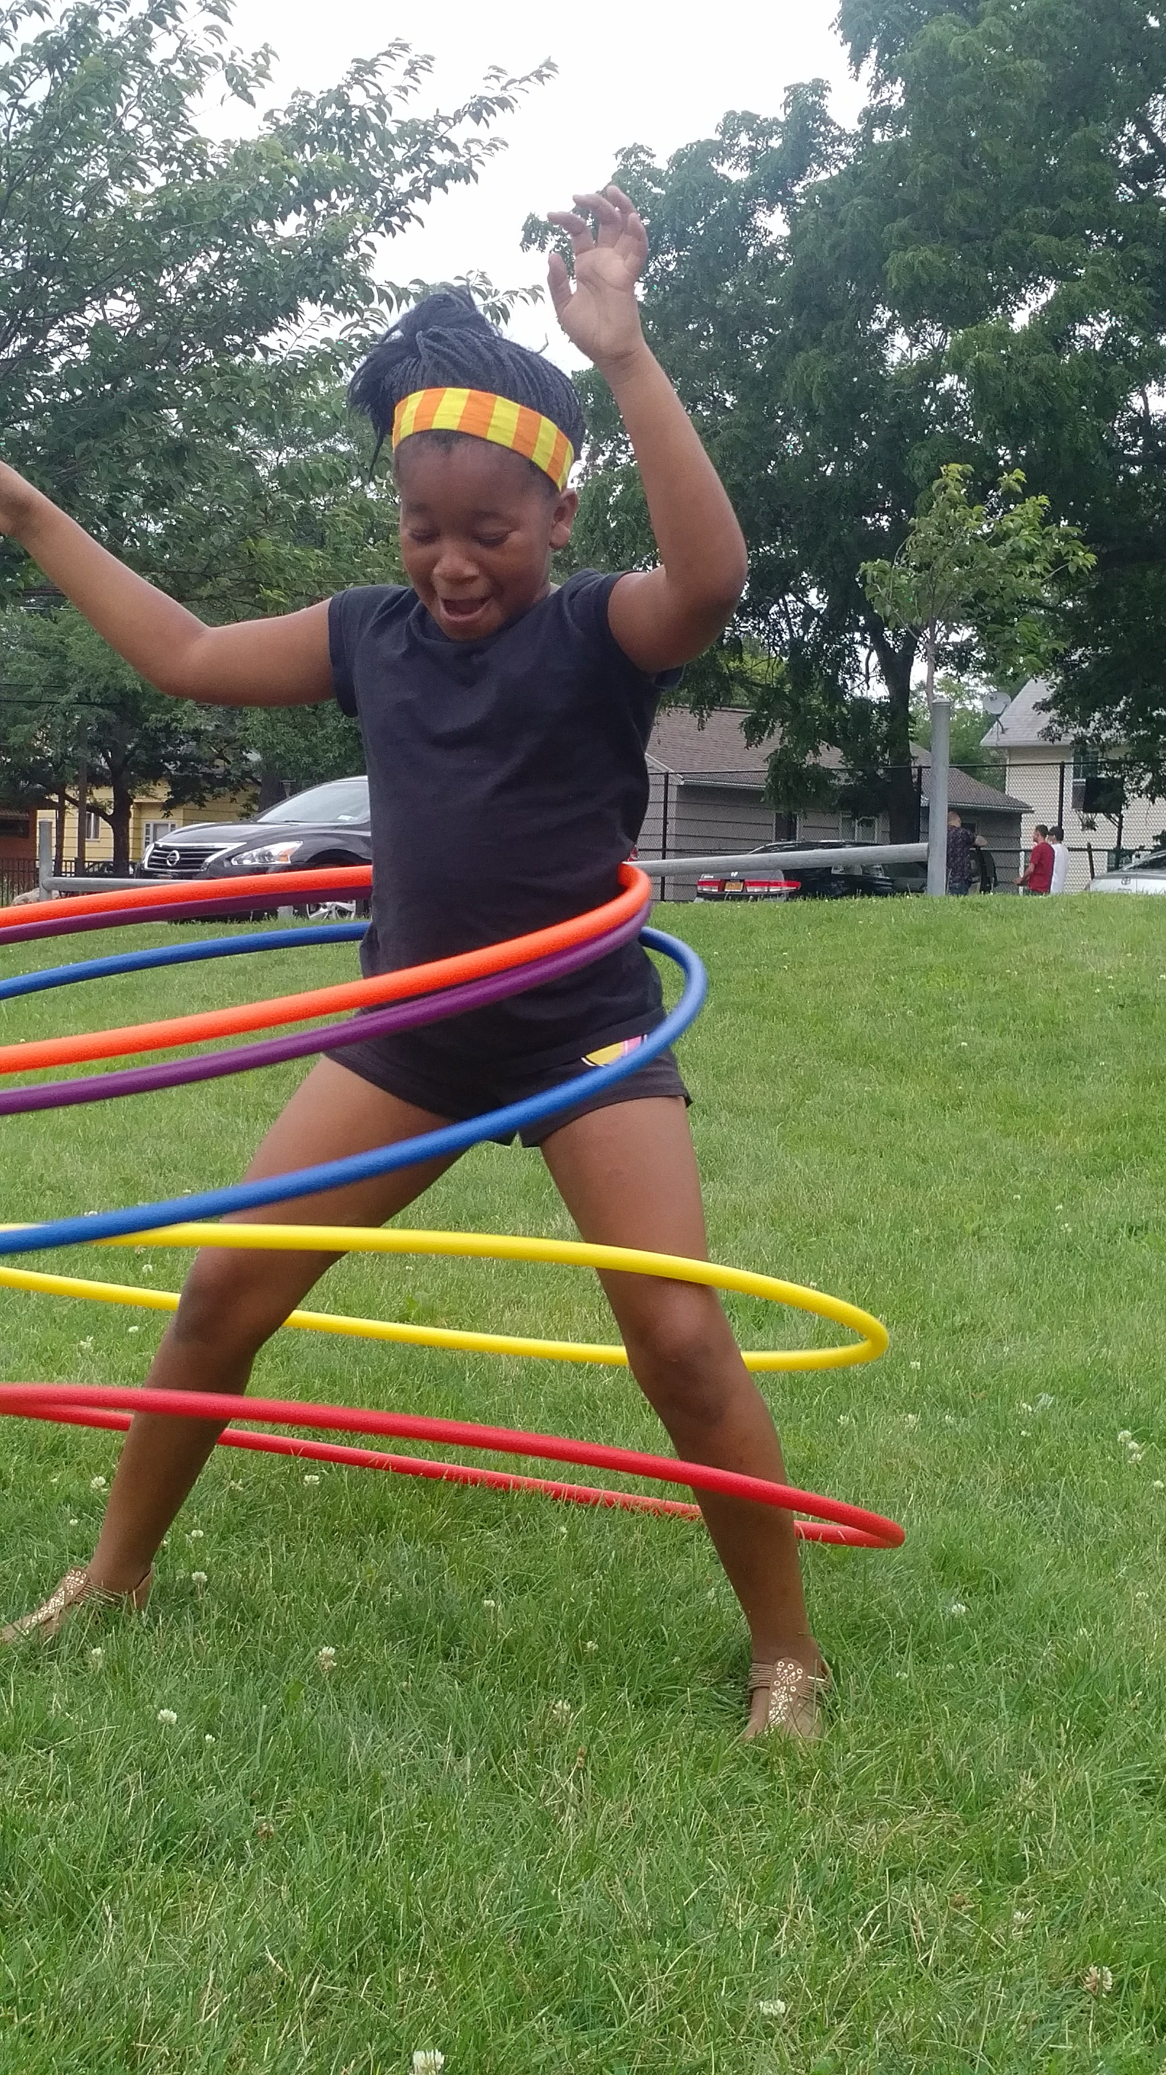
Our Advocacy Agenda
Healthy Learning Environments
Access to Services
Equitable Communities
The Power of Play
Notes:
to our kids’ physical and social emotional health

Slide 13
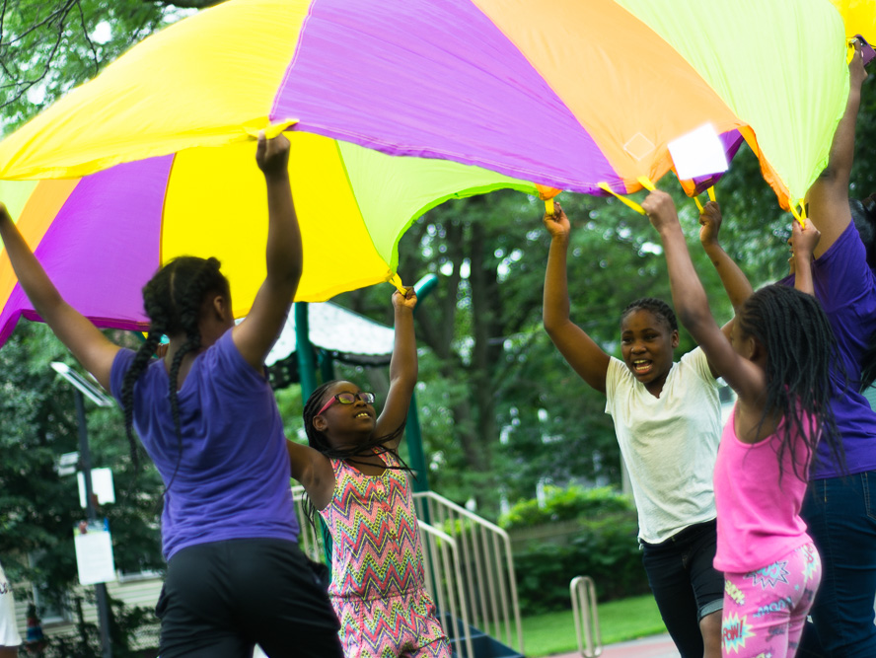
What is Advocacy?

Slide 14

Advocacy is many things…
Education
Raising awareness
Working with public officials
Building relationships with local leaders
Coalition building and
Mobilization of resources

Slide 15
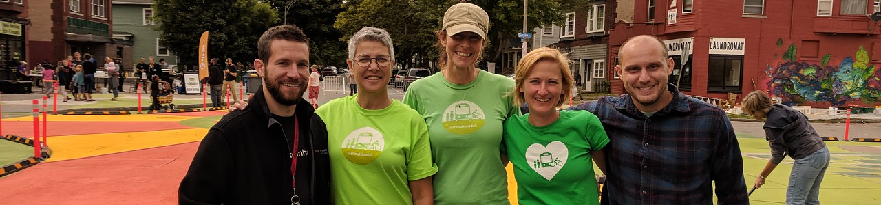
In other words
Advocacy helps us educate decision-makers on what we know is right for families and kids across our community by sharing our insights, stories, and data.

Slide 16
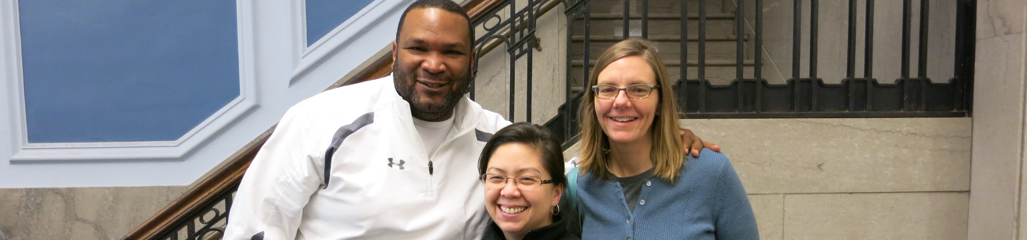
The advocate in me
[Customize to reflect you, below is Jenn’s e.x.)
Woman
Sister, wife, aunt
Social justice advocate
Voting rights advocate
Advocacy campaign professional
Notes:
Ask: How are you an advocate? What ways are you an advocate?

Slide 17
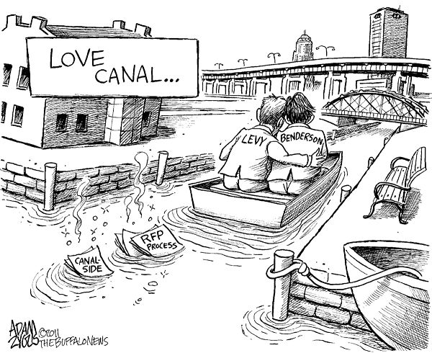
Does my voice matter?
Notes:
This is just a quick story about Lois Gibb. The basics: Lois is a mother. Lived in Love Canal NY, where the community was experiencing a high rate of birth defects, cancer, and other health effects due to a company dumping 21,000 tons of toxic waste into the ground where a school and an entire community was built on top of it. Lois was a mother, wanted to go door to door and organize her community because her son was sick. She explained how she tried and failed to go up to her first neighbors door night after night, and when she was going to knock on the door she was overwhelmed with fear. Then the next night she brought her son with her and was able to start organizing, which led to the supreme court ruling of protected waterways, and that’s why we have superfund sites today. So, the point is, one person can make a difference.

Slide 18
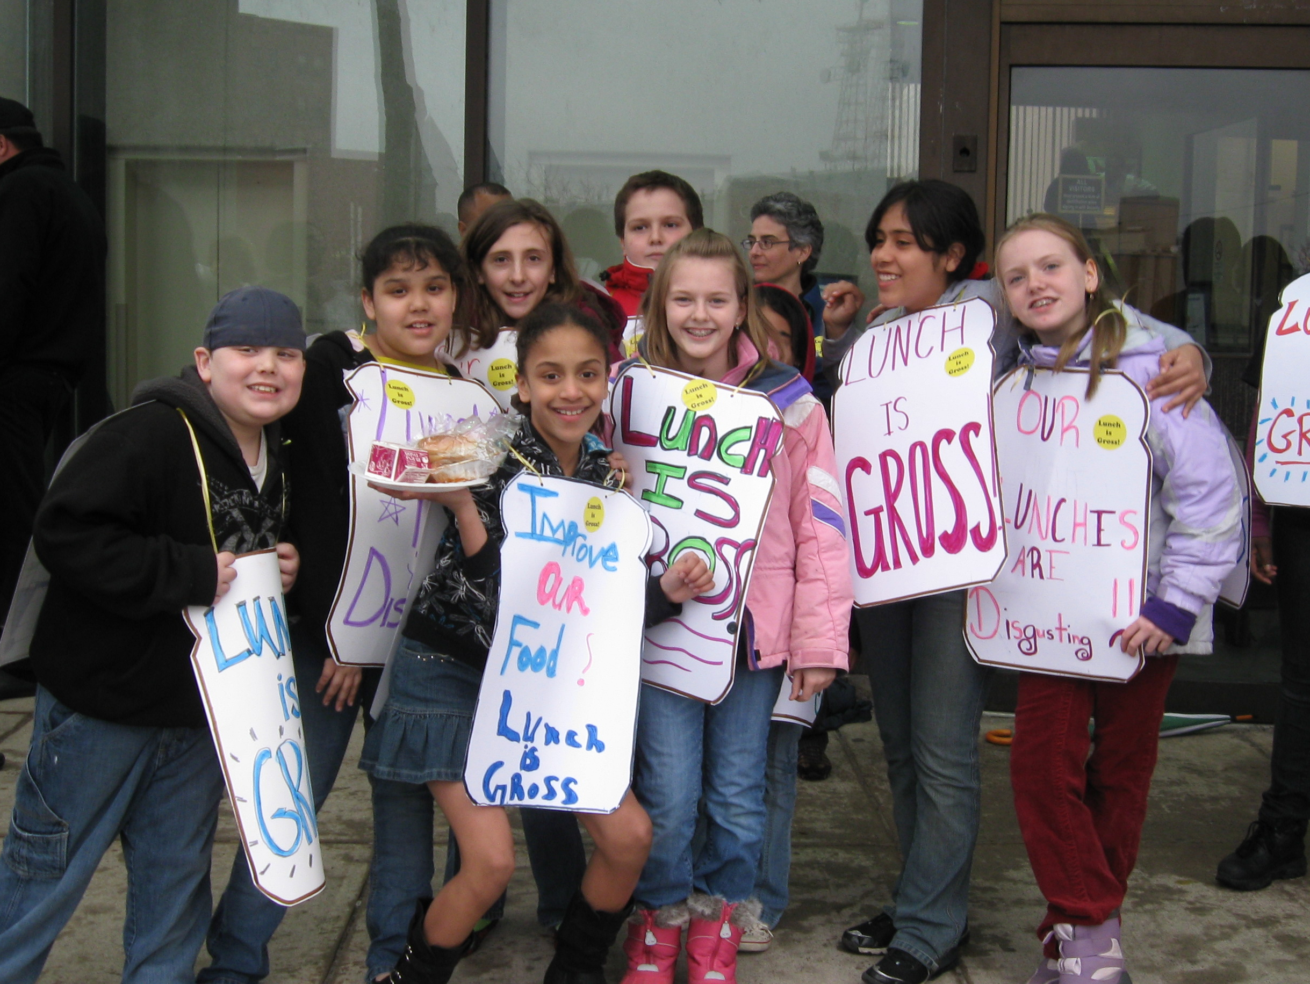
Improving school meals for all kids

Slide 19
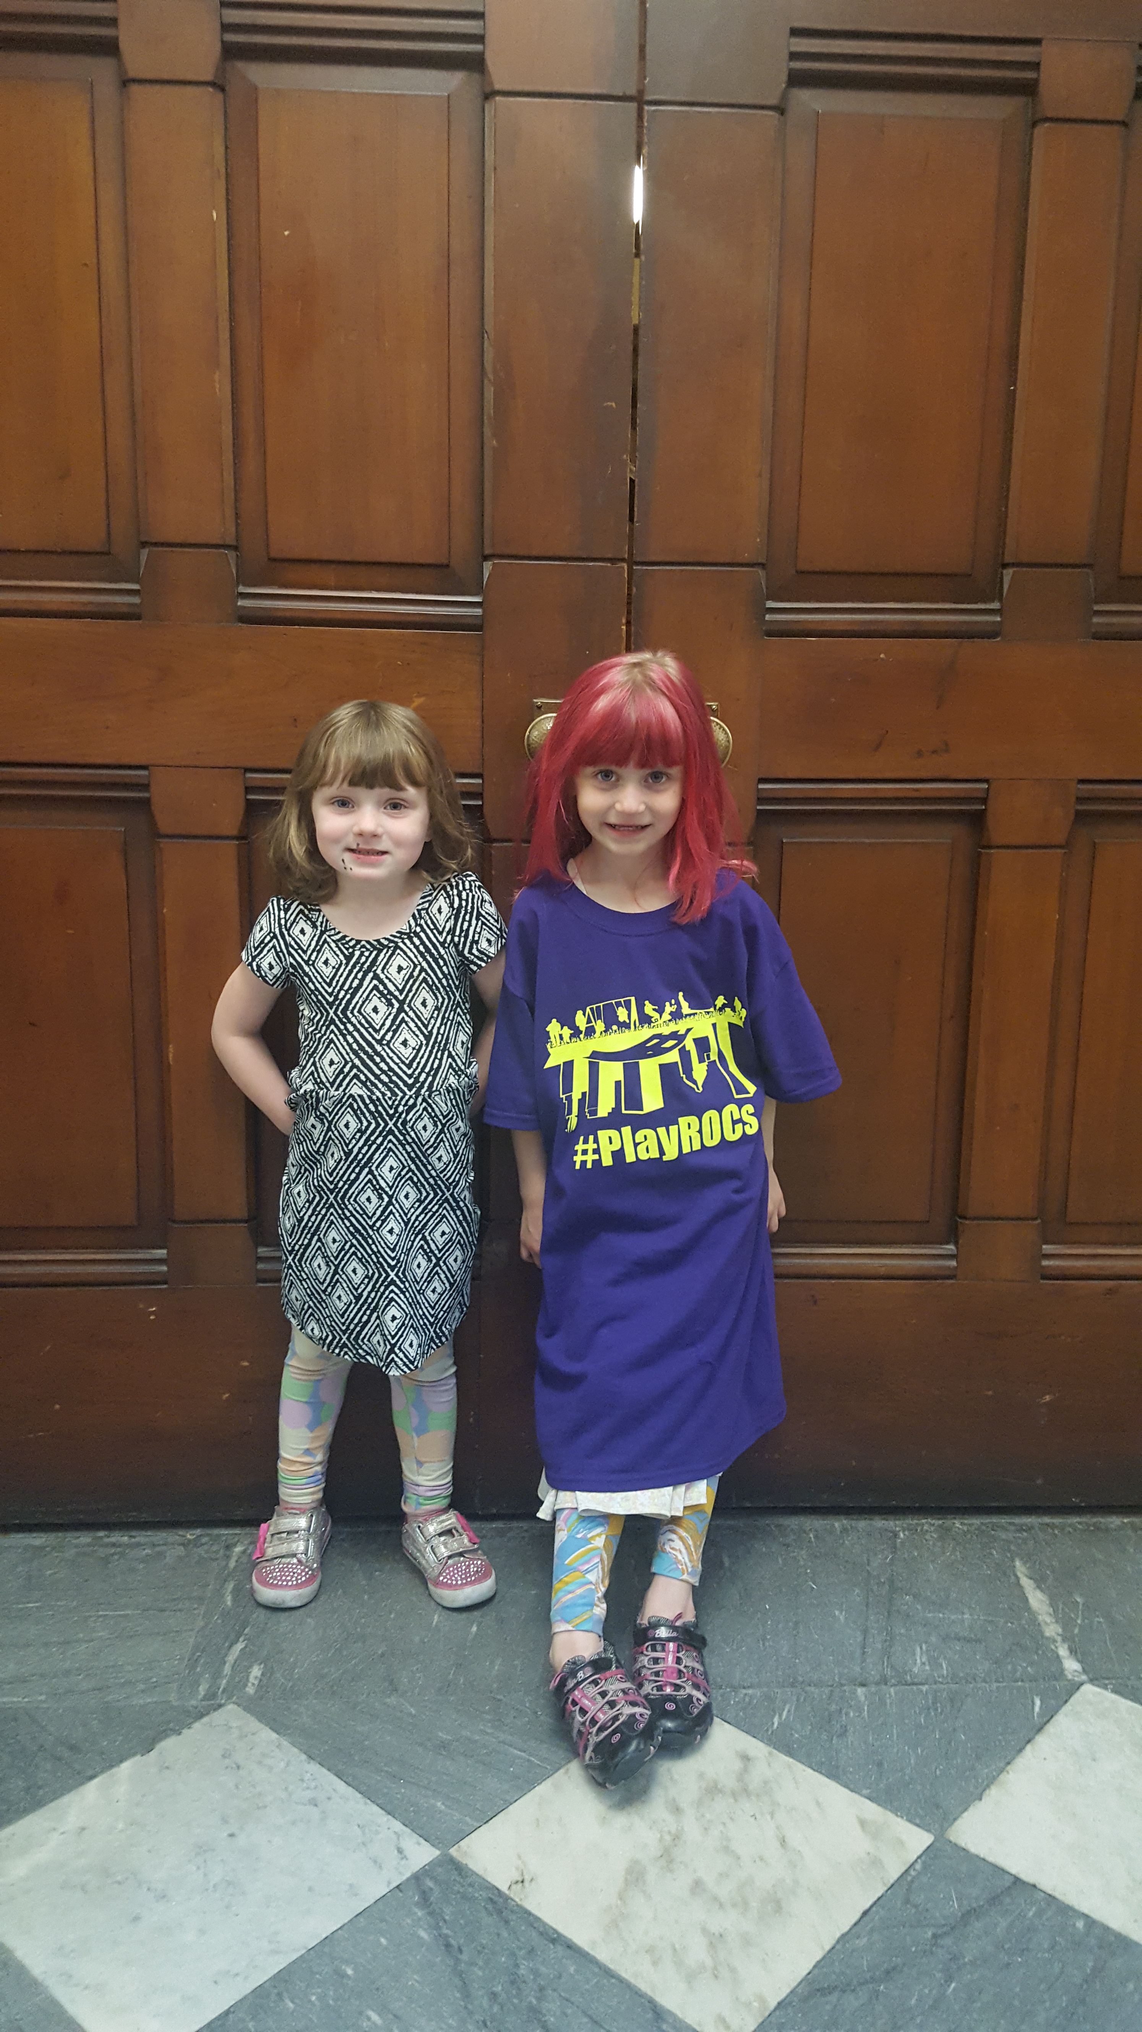
Getting signs around their playground to slow down traffic

Slide 20
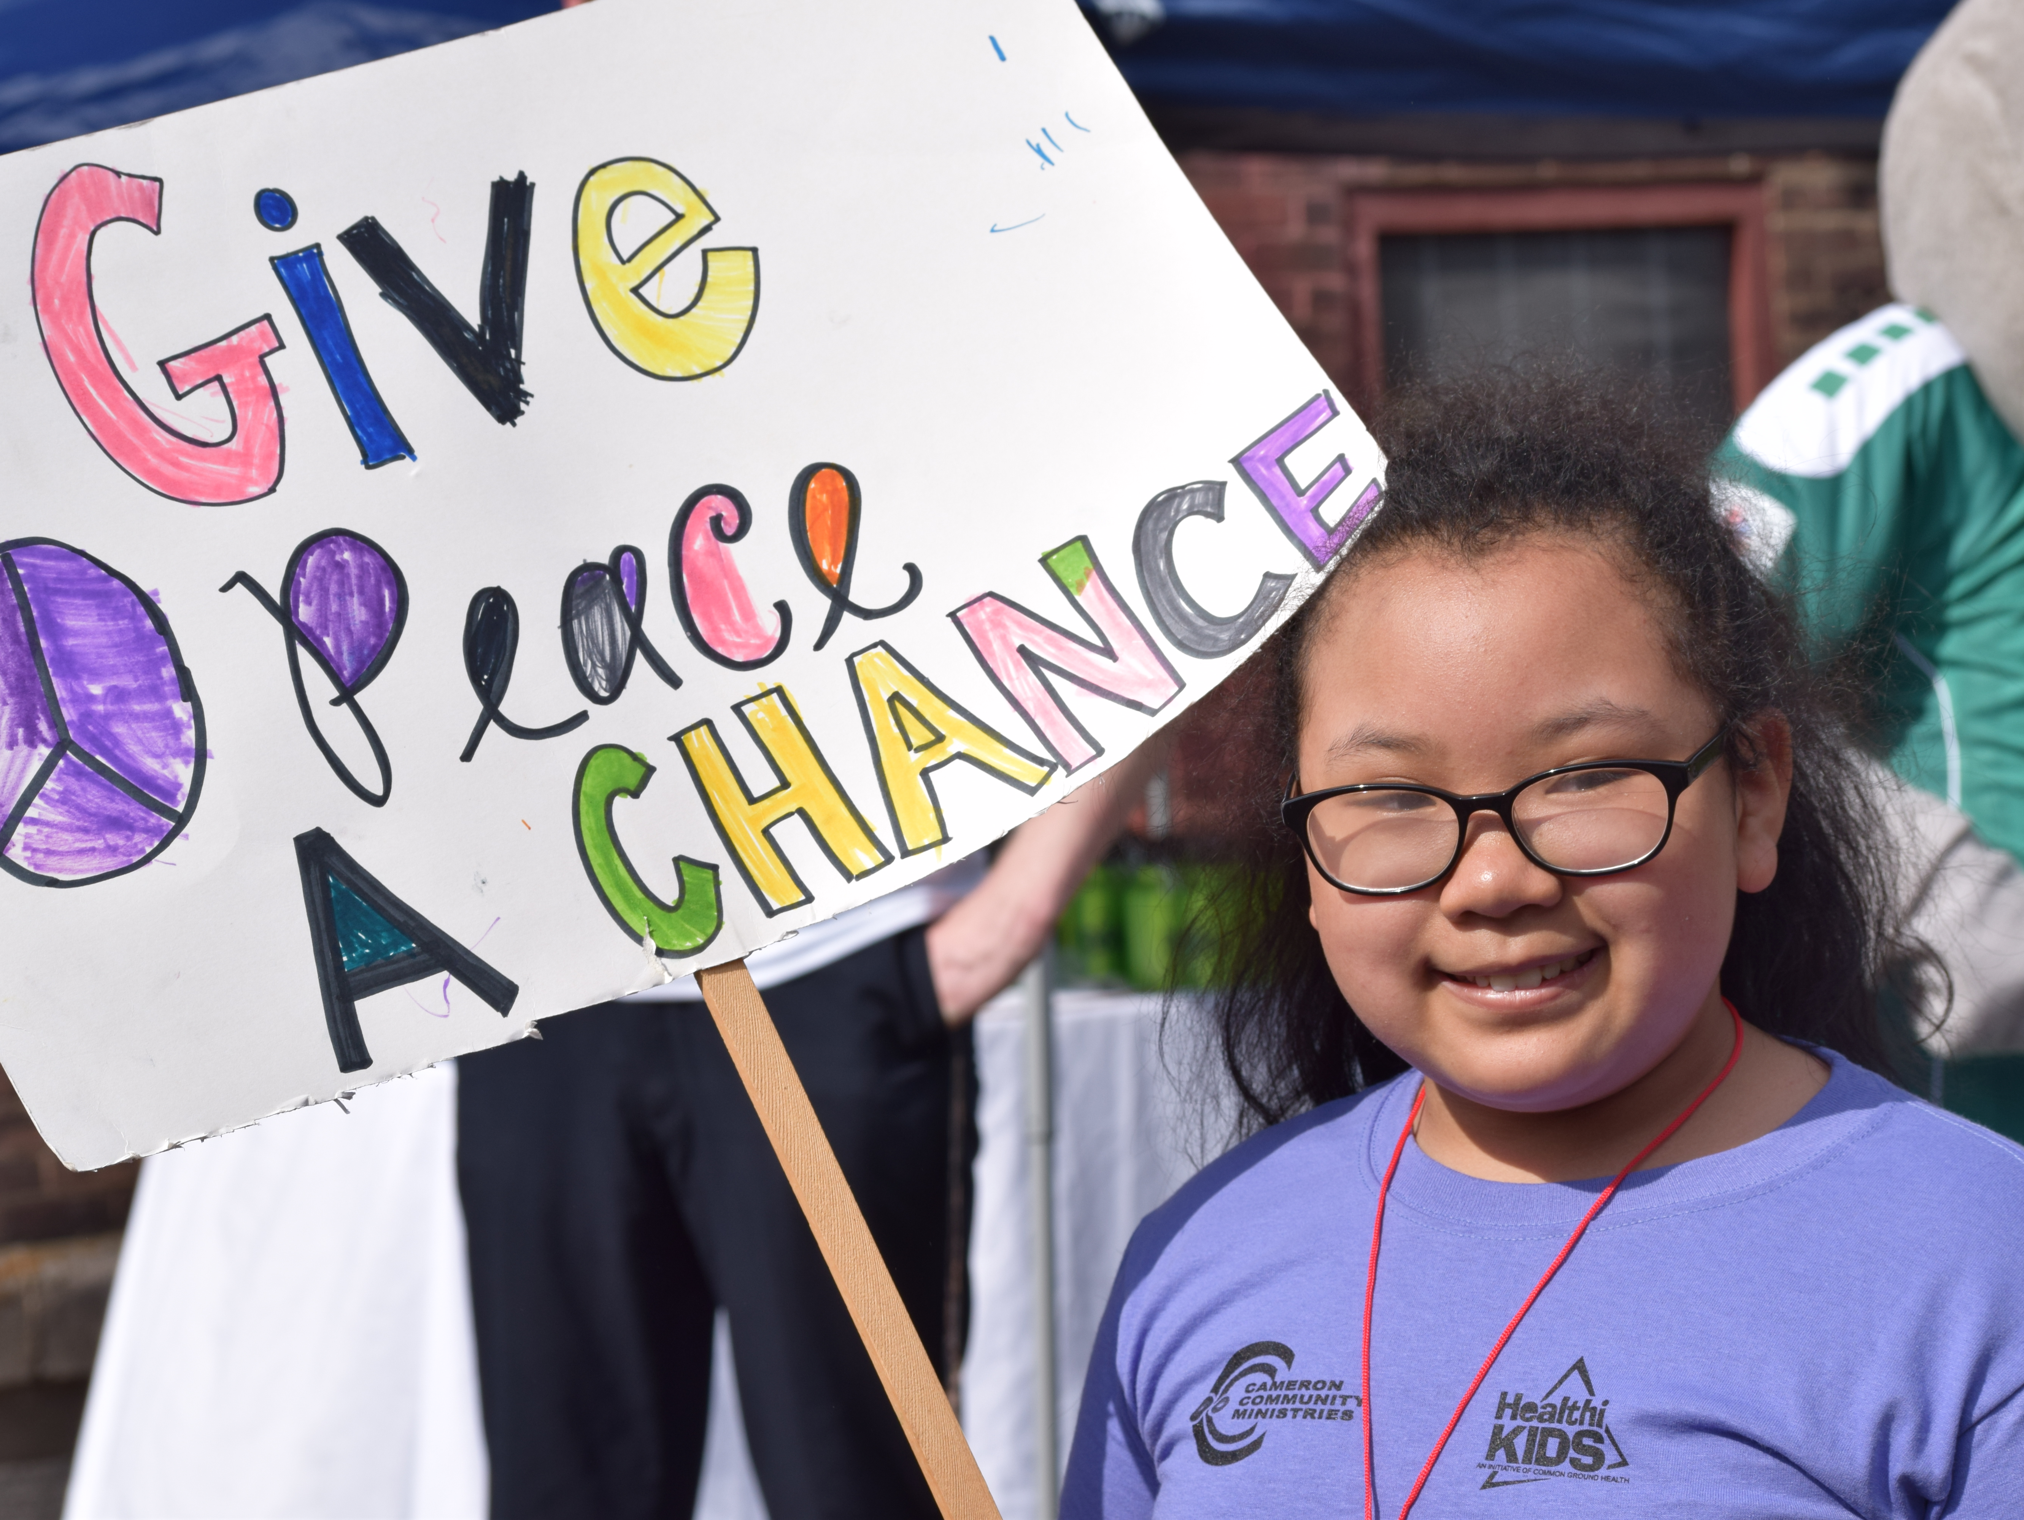
Stepping out and standing up against gun violence

Slide 21
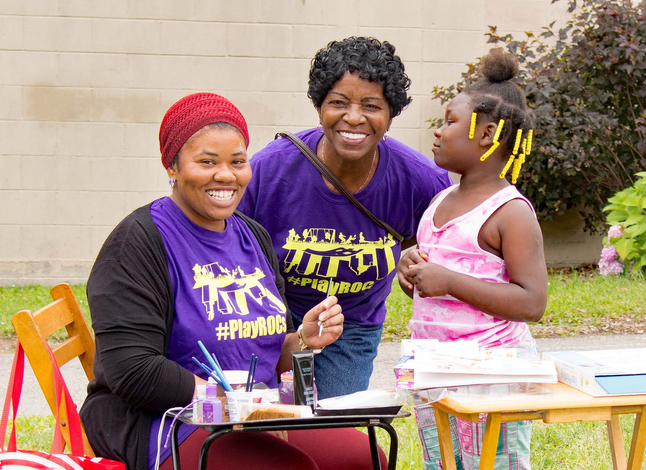
Creating safe places to play in their neighborhood

Slide 22
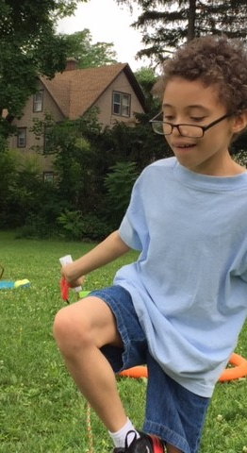
People usually think advocacy is…
Writing letters to elected officials
Writing a letter to the editor
Signing a petition
Calling your elected official
Setting up a meeting with your elected official
Signing up to speak at meetings

Slide 23
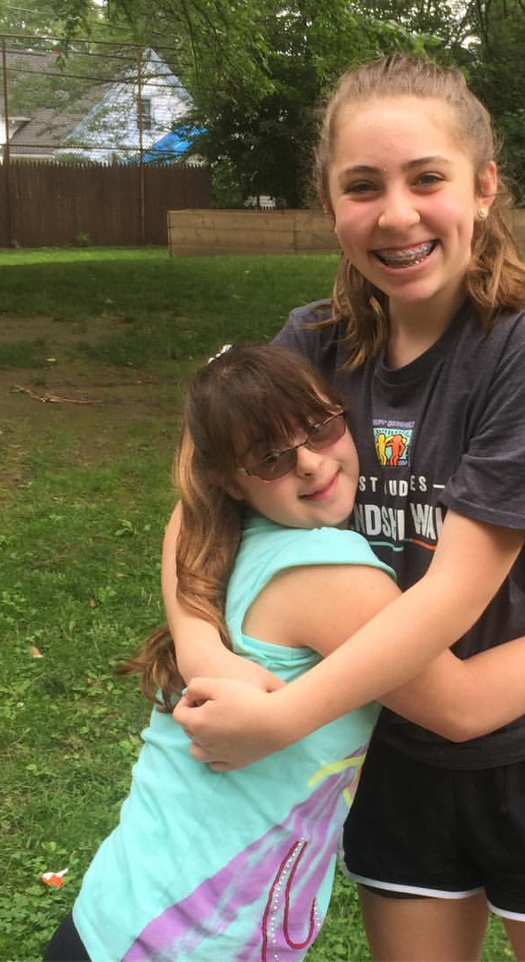
But it’s also…
Signing on to policy alert newsletters
Participating in discussions on social media
Organizing your friends to go to these activities with you
Elevating your voice at community meetings
Speaking up for your peers
Advocating for your child at school

Slide 24
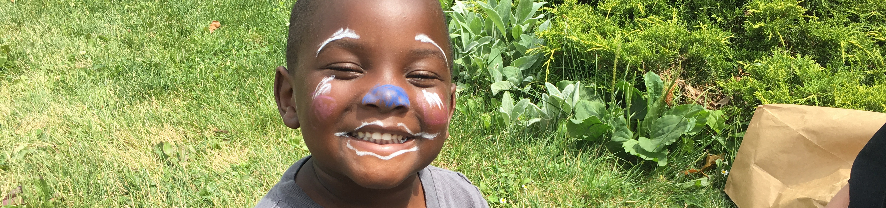
Most Importantly
It’s about sharing YOUR STORY.

Slide 25
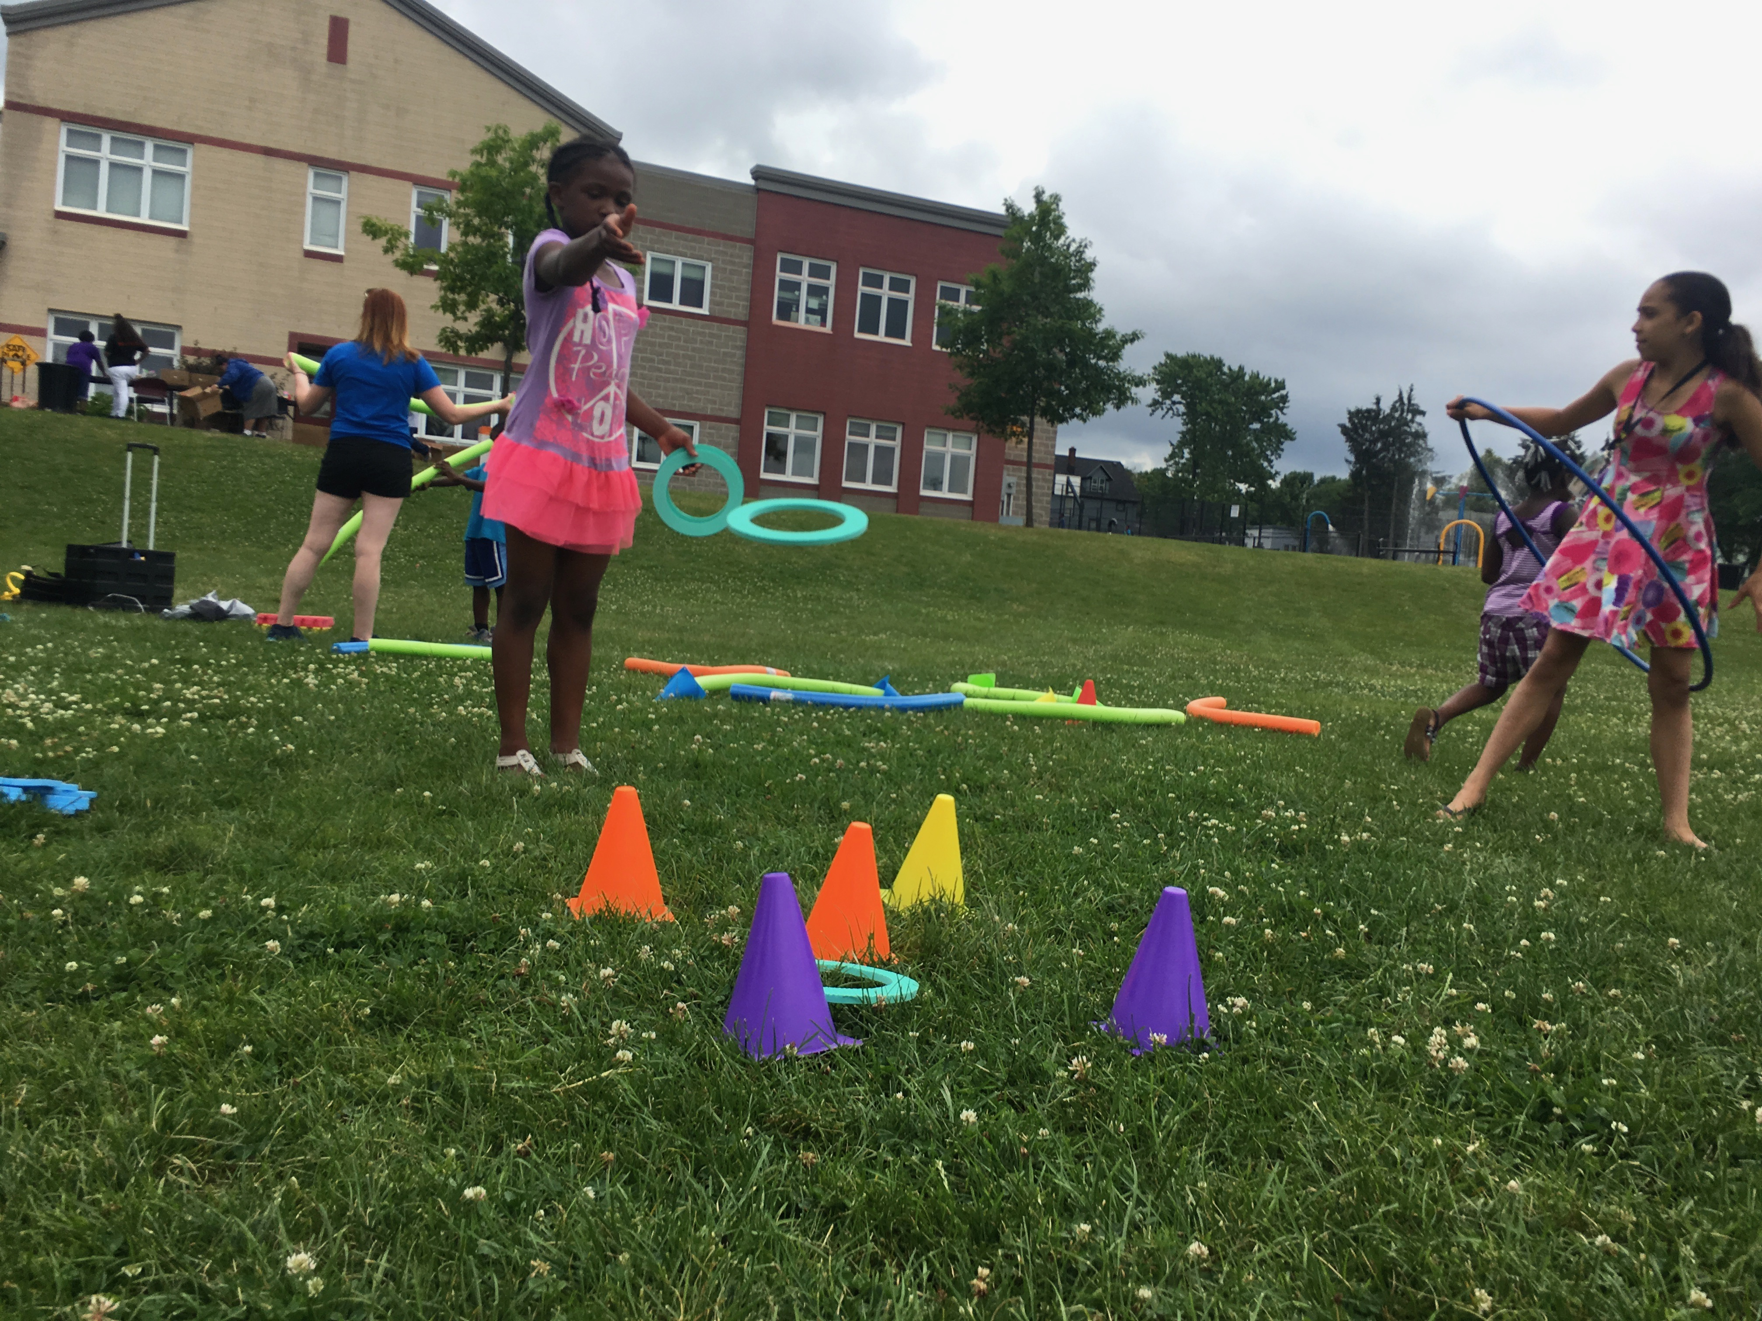
Getting Involved in Advocacy: Where to Start

Slide 26

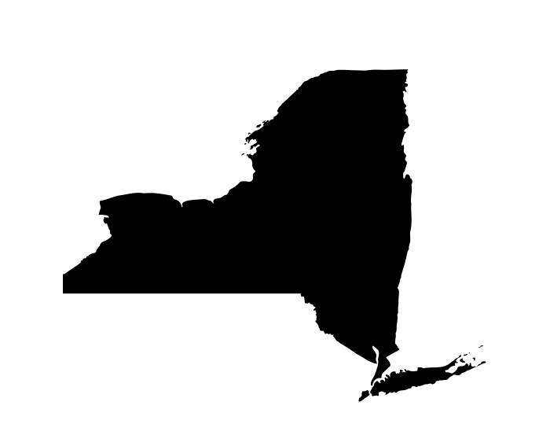



What levels of advocacy are there?
This Photo by Unknown Author is licensed under CC BY-SA

Slide 27

Know the right audience
Notes:
Because there’s levels of government, and different audiences, you want to make sure you know who to target for your ask to.
Every level of government is responsible for different things. It’s important to know WHO is responsible for what you want. E.g. if you want to increase access to behavioral health supports for your child, you wouldn’t necessarily go to the city government to ask for this. Instead, it may be your child’s school principal, the school board or the state.
If you’re not sure who to go to – work with Healthi Kids! Our staff can help direct you to the right resources for your advocacy.

Slide 28
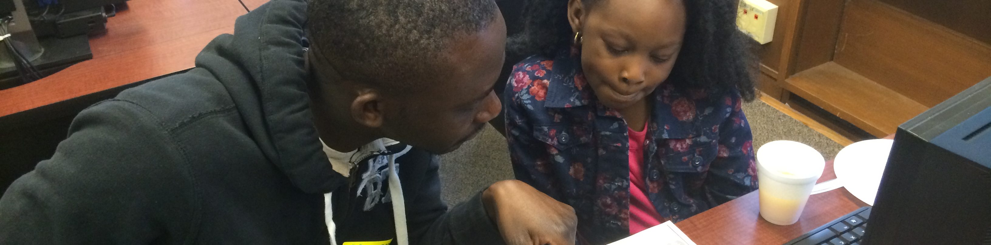
What do you want?
Develop SMART messages
S – Specific
M – Measurable
A – Achievable
R – Realistic
T – Time bound
Notes:
Now that we know there’s different places where we can advocate, we need to think about now what we want to tell our elected officials.
***activity: brainstorm with the group ideas of advocacy areas they want for their kids: e.g. better school meals, access to healthier foods in their neighborhood, implementing daily active recess, increased access to EI services.
***activity #2: from the initial brainstorm of all the ideas they’d want, ask them to narrow it down: What is the one thing you would want to share with your decisionmaker (e.g. elected official, Principal, etc) today?
Specific:
Asks are specific when they refer to an action or behaviour that can be observed and tracked. For example, direct your ask at a specific government department, requesting that they accomplish a change that is in their power. By making your recommendations specific rather than generalized, the likelihood of seeing change increases as you are able to pinpoint to your audience specific cases.
E.g. Instead of just saying I want to improve school meals because my children want better food. You can be more specific and say, I want more dollars towards high quality school meals and scratch cooking so that my children can have better food.
Measurable
For a recommendation to be successful it must be achievable. Try to include a request for actions that can be observed or measured.
E.g. instead of “I want this to happen soon” share “In this budget year, I’m asking you to put more dollars towards school meals to support scratch cooking:
Achievable
For a recommendation to be achievable it must have a likelihood of success. When directing your recommendations at government, refer back to “what government can and cannot do”.
E.g. instead of asking your school Principal, it may be an opportunity to go to the School Board and Superintendent instead. Asking for improved school meals. Remember: if you want more money to go towards better school meals, getting infront of the School Board and those that make the decisions during Budget Committee meetings are KEY! All of these happen BEFORE the budget is passed at a School Board meeting
Realistic
Also ensure that your recommendations reflect either resources that are either open to you, or government, or resources that can be worked towards.
E.g. We hear a lot of kids ask for things like “chocolate fountains”, “dessert buffets” or “Beyonce performing” during school lunch. Obviously all of these are far fetched. Think about what’s reasonable and realistic. We may not be able to ask for chocolate fountains, but we can ask for more investment in things like salad bars.
Time Bound
Finally, if possible, try to include timeframes within your recommendation. Indicate a clear start and end date for when you would like to see change occur. Perhaps even include interim steps to reach your goal. Including a timeline will make future monitoring of your progress easier.
Hold your elected official to a time. If you leave it open ended it doesn’t give them any urgency to respond. E.g. Instead of “I want you to improve school meals”. “This budget season, I want you to improve school meals by investing now in more salad bars and scratch cooking”.
Examples of SMART messages:
This budget season, I want you to improve school meals by investing now in more salad bars and scratch cooking”.
This summer, include play in the city’s comprehensive plan by voting to adopt the plan
Ensuring all kids have access to high quality out of school time programs is important to me. This budget season, continue your investment by adding $15M to the Advantage After School Program.
I cannot find adequate services for my child, I know there’s an issue, and I’ve been referred, but there’s no provider to do it. This year, I’m asking you to allocate $100M dollars to enhance behavioral health infrastructure for kids in Rochester, NY.

Slide 29

Message checklist
Your message shares why you’re there
It is clear and straight to the point
It defines an action for the elected official
It is framed to your audience (why do they care about this?

Slide 30
Practicing SMART Messages
Notes:
***activity: brainstorm with the group ideas of advocacy areas they want for their kids: e.g. better school meals, access to healthier foods in their neighborhood, implementing daily active recess, increased access to EI services.
Take one example and share how they can be SMART (healthier school meals is highlighted below)
Ask them to work in pairs to develop their message that follows the SMART guidelines:
School Meals example:
SMART: E.g. Instead of just saying I want to improve school meals because my children want better food. You can be more specific and say, I want more dollars towards high quality school meals and scratch cooking so that my children can have better food.
MEASURABLE: E.g. instead of “I want this to happen soon” share “In this budget year, I’m asking you to put more dollars towards school meals to support scratch cooking:
ACHIEVABLE: E.g. instead of asking your school Principal, it may be an opportunity to go to the School Board and Superintendent instead. Asking for improved school meals. Remember: if you want more money to go towards better school meals, getting infront of the School Board and those that make the decisions during Budget Committee meetings are KEY! All of these happen BEFORE the budget is passed at a School Board meeting
REALISTIC: E.g. We hear a lot of kids ask for things like “chocolate fountains”, “dessert buffets” or “Beyonce performing” during school lunch. Obviously all of these are far fetched. Think about what’s reasonable and realistic. We may not be able to ask for chocolate fountains, but we can ask for more investment in things like salad bars.
TIME BOUND: E.g. Instead of “I want you to improve school meals”. “This budget season, I want you to improve school meals by investing now in more salad bars and scratch cooking”.

Slide 31
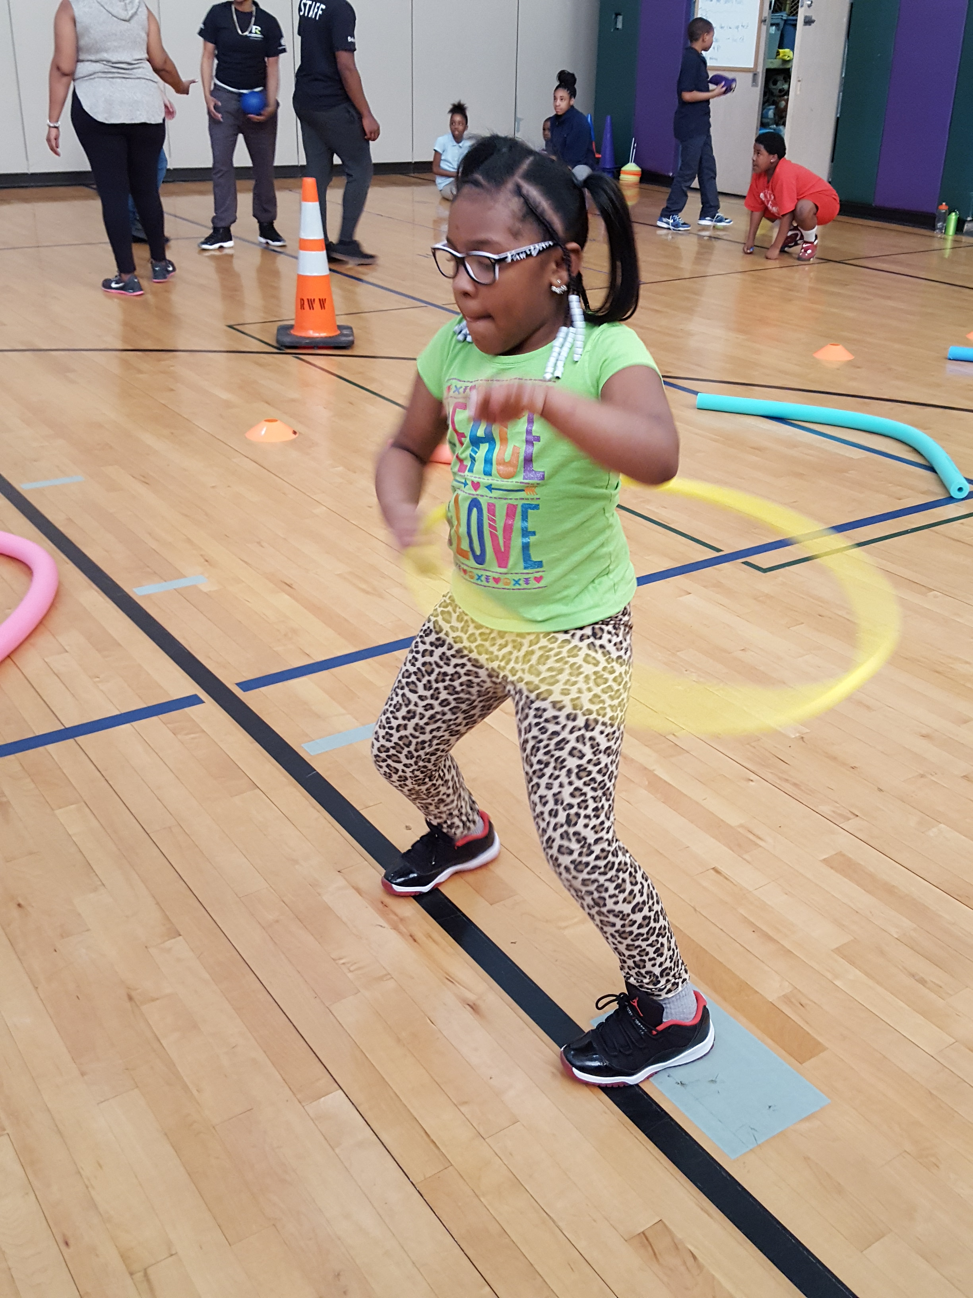
When’s the best time to advocate?
Budget season
When elected officials are in session
When elected officials are debating new legislation
Public meetings
Media moments
Election cycles
ANYTIME!

Slide 32
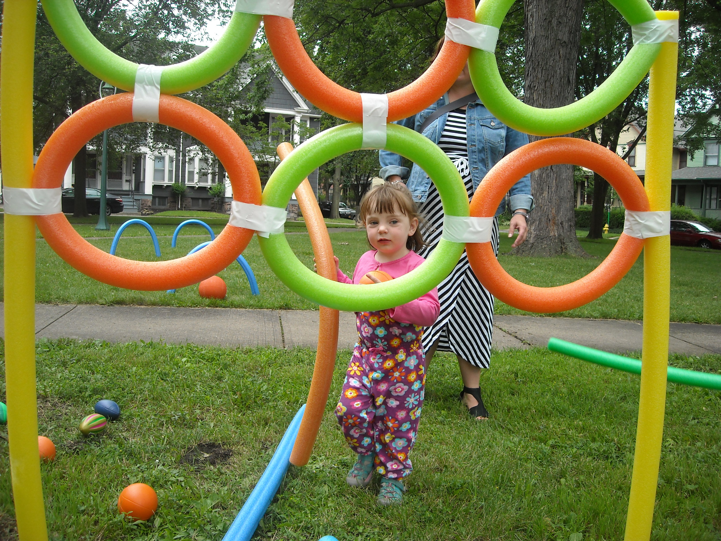
Nuts and Bolts of Advocacy

Slide 33
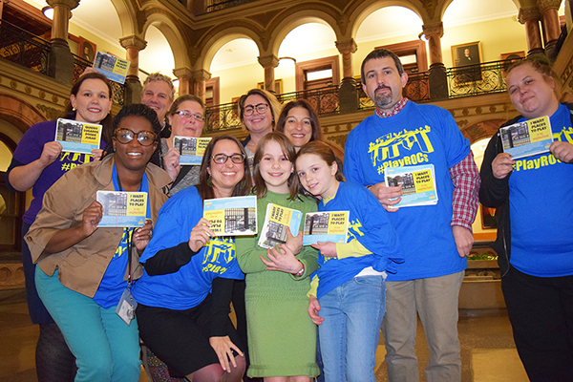
Why reach out to your elected officials?
They represent YOU!
They have the power to change things and write policies that impact you and your family.
They aren’t experts in all topics
They rely on people in their district to share with their stories

Slide 34
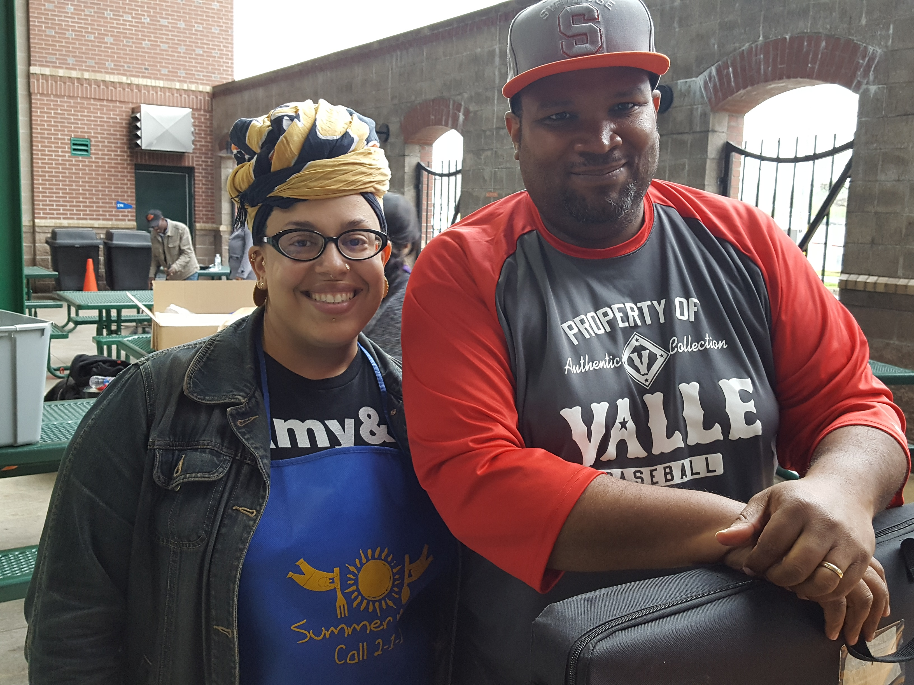
Ways to connect with your elected official
Call or Write
Meet them
Invite them to an event
Join town halls or meetings
Sign up to speak up at school board & council meetings

Slide 35
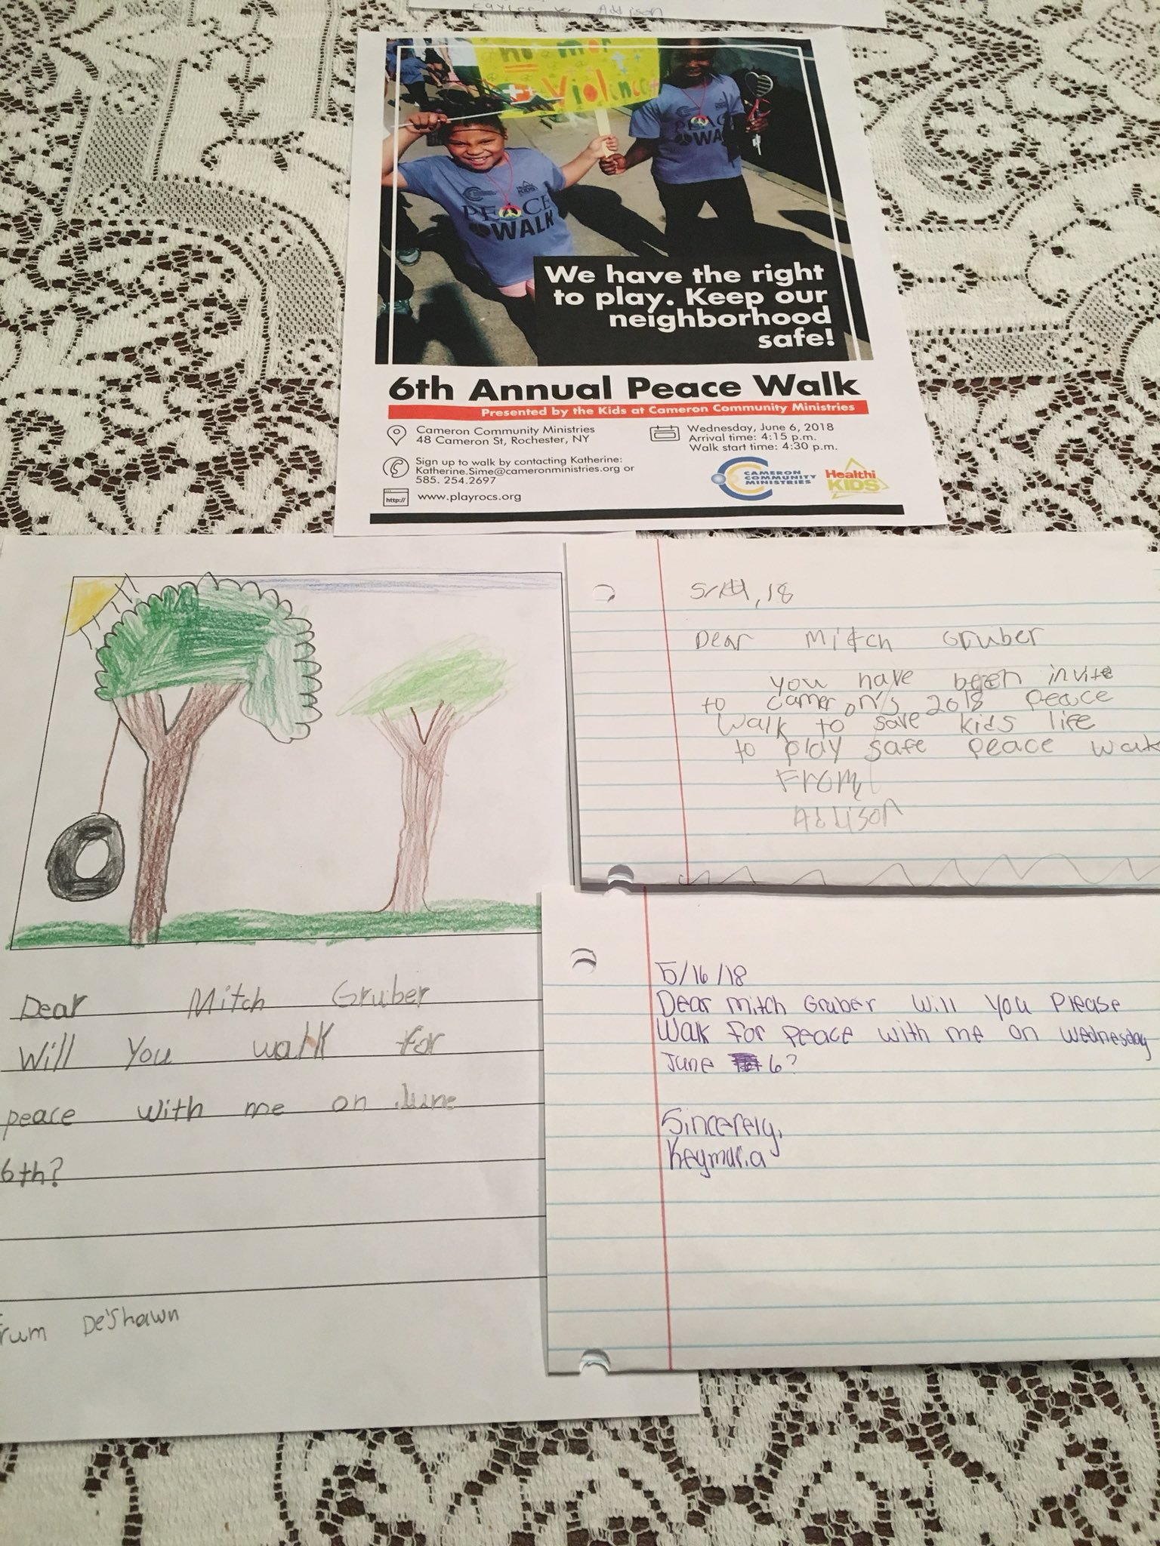
Calling or writing: What to share?
YOUR story!
YOUR message!
YOUR facts!
Photo by: Councilmember Mitch Gruber

Slide 36
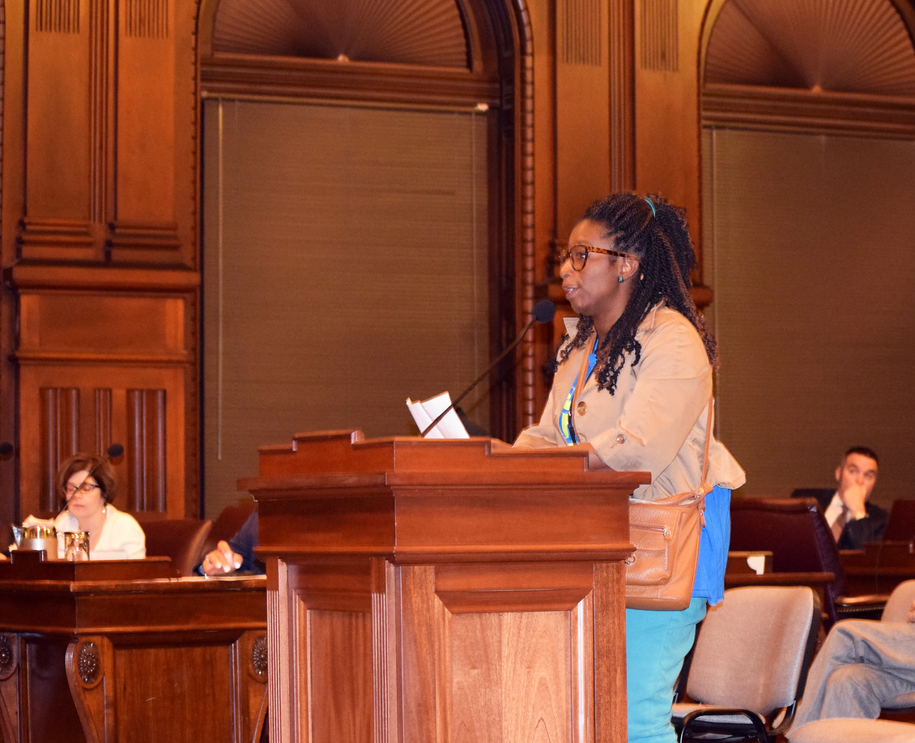
Speaking to Council / School Board
Sign up to speak
Prepare a 2 minute speech
Get across your SMART message
Share YOUR story

Slide 37
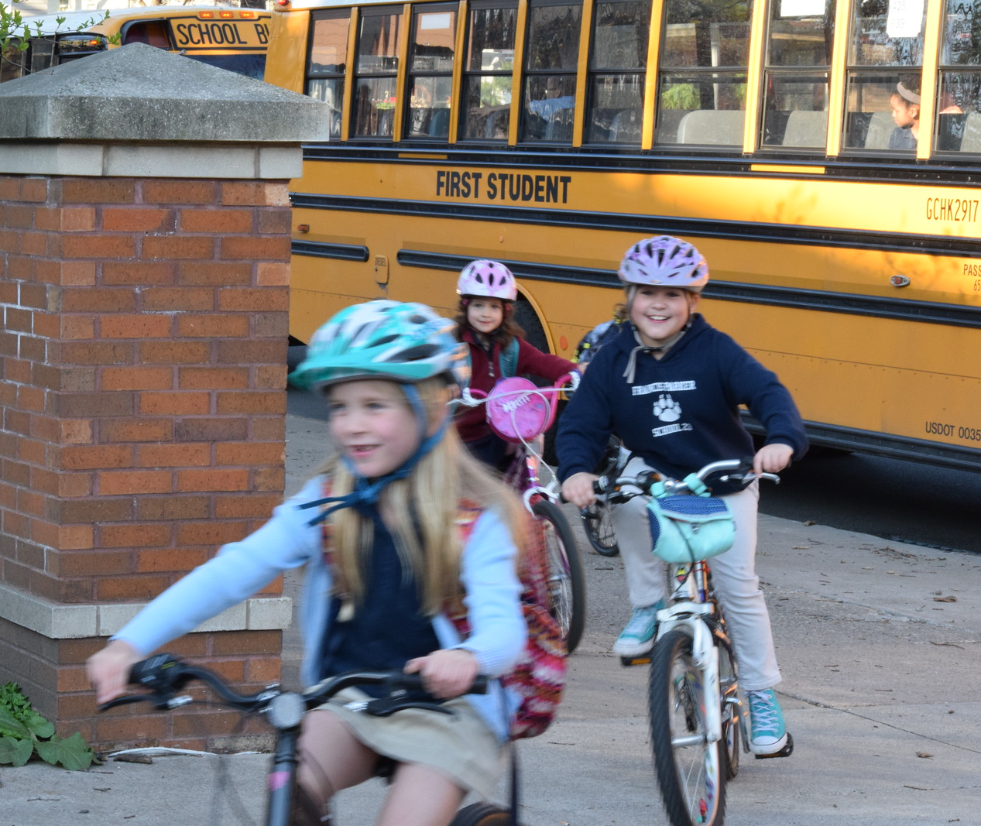
Inviting them to an event
Have an event coming up in your neighborhood or school?
Invite your elected official!
Notes:
This is a great way to share with them what’s going on in your school or neighborhood.

Slide 38
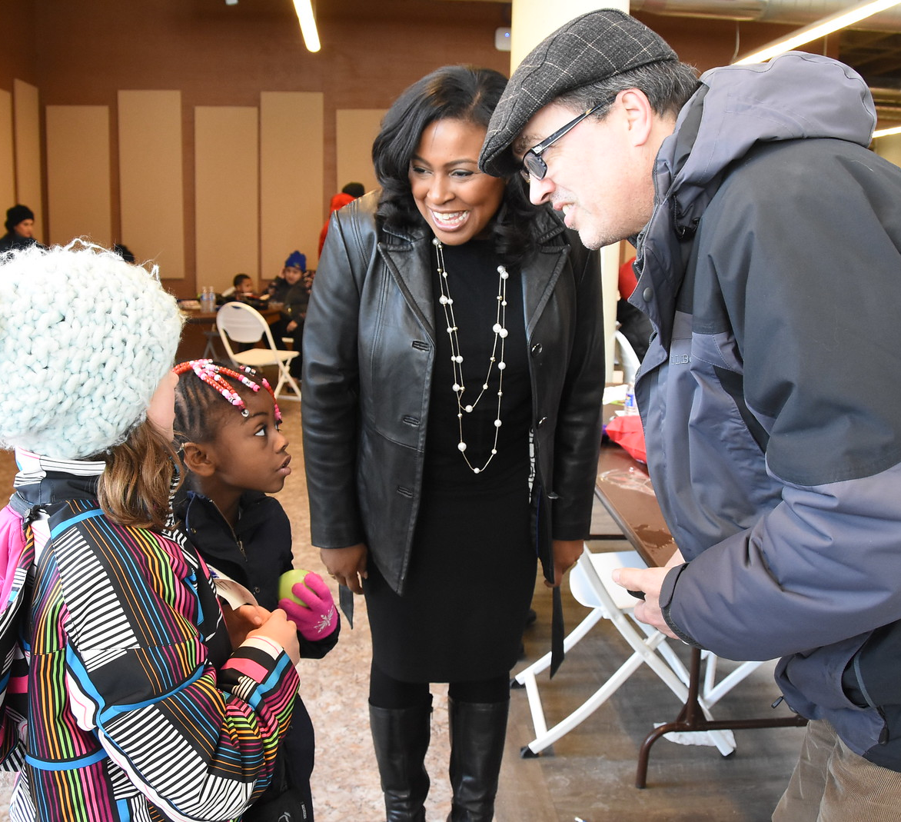
Setting up a 1:1 meeting
Who you are
Why you’re there
What you want
How they can help
When will you follow up

Slide 39
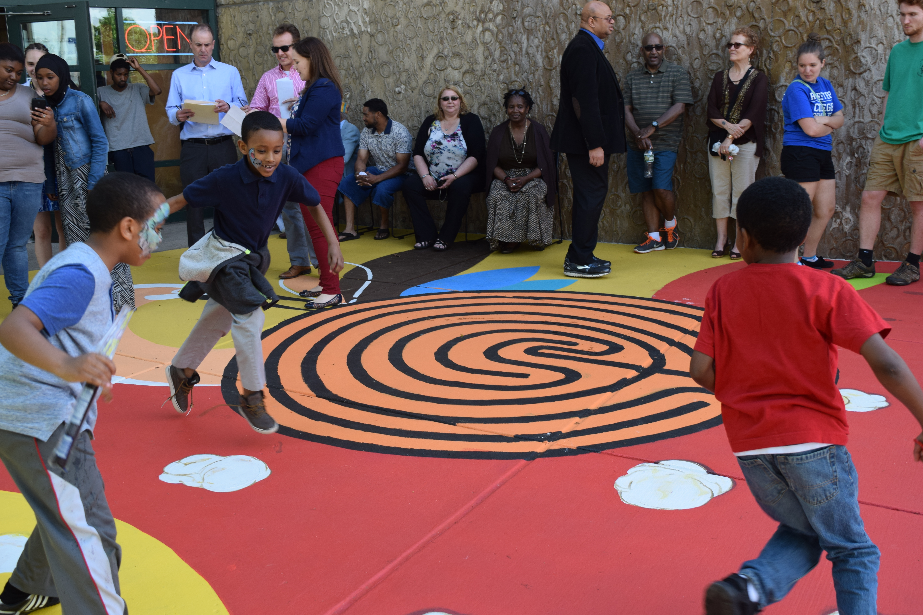
Advocacy Tips

Slide 40
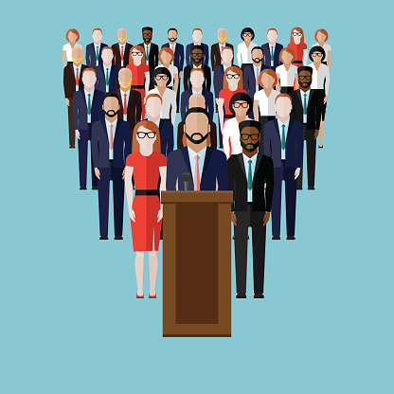
Tips for Contacting your Elected Official
Share that you are their constituent (remember, they work for YOU!)
Make it personal and give details on why it’s important
Follow the key messages
If you need it: write it out!
Don’t be intimidated. Most of the time it is staff or an intern answering your letters or calls

Slide 41
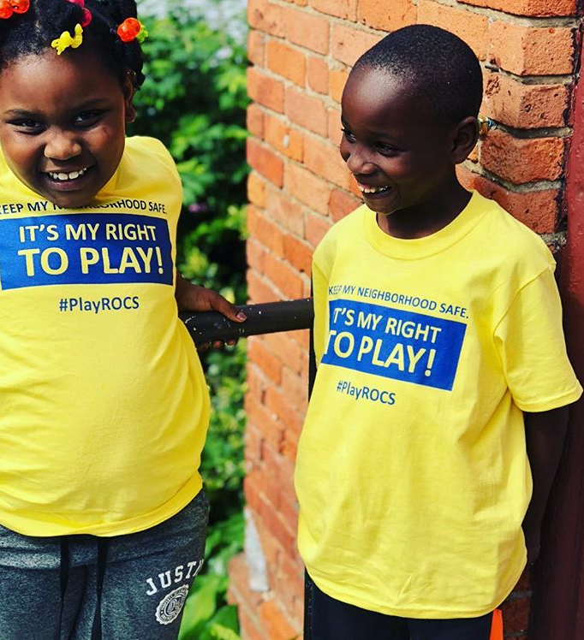
And remember…
Share your story
Be confident
Be prepared
Be optimistic
Make an ask and try to get them to commit!
Follow up
Notes:
Share your story
When sharing your story with your elected official, keep it personal and relate it to the topic that you want to share about.
Be confident
Be confident going in, your legislator wants to hear from YOU. They represent you! At the end of the too, always remember they’re just a person.
Be prepared:
Know what you want to talk about. Think about the points you’d like to get across to your elected official. Be sure that you make this personal!
Be optimistic:
Most elected officials can pick up on the energy that citizens bring into their office through their advocacy efforts. Remain as optimistic as you can, remember you’re building a relationship here! We make more friends with honey than you do with vinegar.
Make an ask and try to get them to commitment:
Asks can be a number of things, from getting them to vote on specific legislation, to coming out to your neighborhood to do a walk, or come to an event. Be sure to be specific
You want to try to get your legislator’s support. So be specific in your ask. This can be “can we have your support to vote in favor of play in the comprehensive plan?”, “will you put more funding towards school meals?”. Ask the question directly to try and get a direct answer.
Follow up:
Remember to send a thank you note after tour meeting with any follow up information that you promised to send. IF you do not know the answer to one of their questions, that’s okay, just let htem know you can find it out and get back to them!

Slide 42
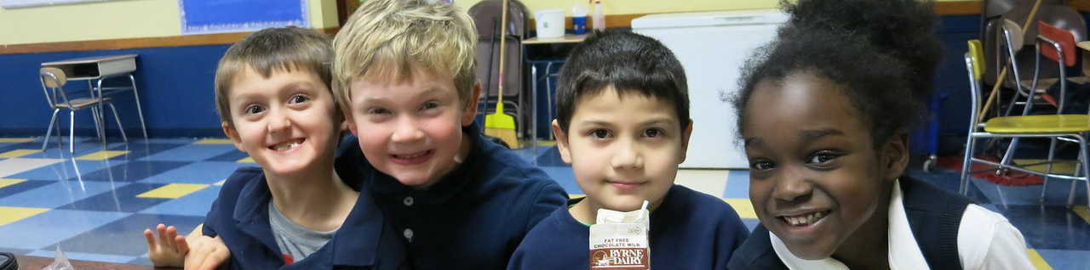
Still Not Sure Where to Start?
Connect with Healthi Kids!
We provide advocacy training to youth and teach them how their voice is an agent of change

Slide 43
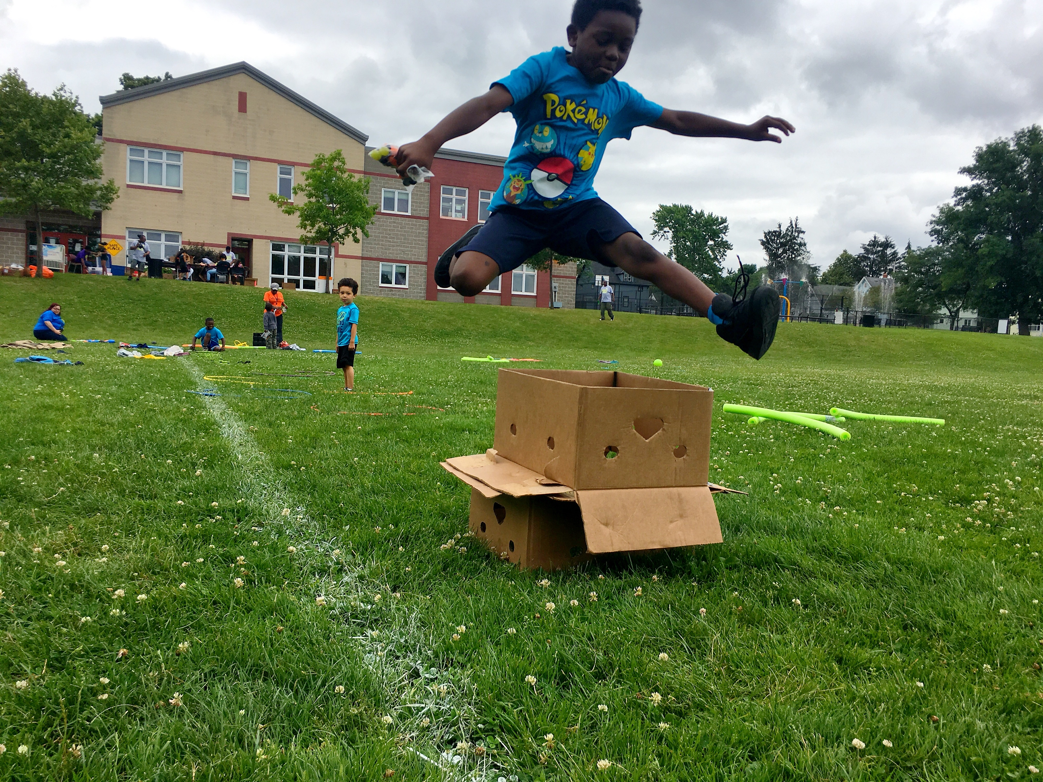
Time to Practice
Notes:
Work through the question worksheet
Who you are:_____________________________________________________________
___________________________________________________________________________________
___________________________________________________________________________________
Why you’re there:____________________________________________________
___________________________________________________________________________________
___________________________________________________________________________________
___________________________________________________________________________________
___________________________________________________________________________________
___________________________________________________________________________________
What you want: ________________________________________________________
___________________________________________________________________________________
___________________________________________________________________________________
___________________________________________________________________________________
___________________________________________________________________________________
___________________________________________________________________________________
How can they help:_______________________________________________
___________________________________________________________________________________
___________________________________________________________________________________
___________________________________________________________________________________
___________________________________________________________________________________
___________________________________________________________________________________
___________________________________________________________________________________
___________________________________________________________________________________
___________________________________________________________________________________
___________________________________________________________________________________
___________________________________________________________________________________
When will you follow up:
___________________________________________________________________________________
___________________________________________________________________________________
___________________________________________________________________________________
___________________________________________________________________________________
___________________________________________________________________________________
___________________________________________________________________________________
___________________________________________________________________________________

Slide 44




Contact Information
Jenn Beideman
Advocacy Manager
Email: jenn.Beideman@commongroundhealth.org
Phone:585-224-3151
1150 University Ave | Rochester, N.Y. 14607-1647 | (585) 224-3101

